Slide 1
Network Operations

Slide 2
Overview
Network Operations
Given a scenario, use appropriate documentation and diagrams to manage the network.
Compare and contrast business continuity and disaster recovery concepts.
Explain common scanning, monitoring and patching processes and summarize their expected outputs.
Given a scenario, use remote access methods.
Identify policies and best practices.

Slide 3
What Are Integrity and Availability?
Integrity
  Soundness of network’s programs, data, services, devices, connections
Availability
  How consistently and reliably a file or system can be accessed
Uptime
  Measure of time functioning normally between failures
  Often expressed as percent uptime

Slide 4
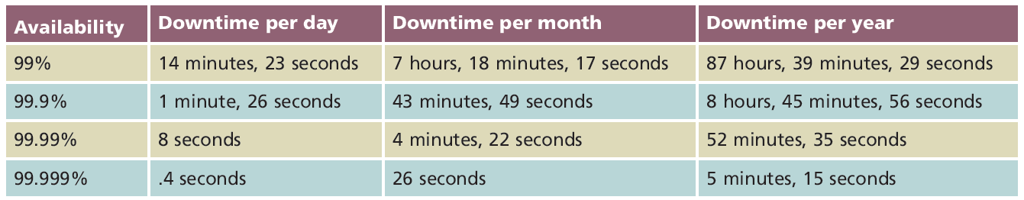
Relation between Availability and Downtime

Slide 5
What Are Integrity and Availability? (cont’d.)
Integrity and availability compromised by:
  Security breaches
  Natural disasters
  Malicious intruders
  Power flaws
  Human error
Follow guidelines to keep network highly available
  Industry or self-developed.

Slide 6
Malware (Malicious Software)
Program designed to intrude upon or harm system, resources
  Examples: viruses, Trojan horses, worms, bots
Virus
  Replicating program intent to infect more computers
  Copied to system without user knowledge
  Replicates through network connections or exchange of external storage devices
Well known how to protect against…..

Slide 7
Fault Tolerance
Capacity for system to continue performing
  Despite unexpected hardware, software malfunction
Failure
  Deviation from specified system performance level
    Given time period
Fault
  Malfunction of one system component
  Can result in failure
Fault-tolerant system goal
  Prevent faults from progressing to failures

Slide 8
Environment
Consider network device environment
Protect devices from:
  Excessive heat, moisture
    Use temperature, humidity monitors
  Break-ins
  Natural disasters

Slide 9
Power
Blackout
  Complete power loss
Brownout
  Temporary dimming of lights
Causes
  Forces of nature
  Utility company maintenance, construction
Solution
  Alternate power sources

Slide 10
Power
Power flaws not tolerated by networks
Types of power flaws that create damage
  Surge
    Momentary increase in voltage
  Noise
    Fluctuation in voltage levels
  Brownout
    Momentary voltage decrease
  Blackout
    Complete power loss

Slide 11
What can we do?
Uninterruptible power supplies (UPSs)
  Battery-operated power source
  Directly attached to one or more devices
  Attached to a power supply
  Prevents harm to device, service interruption

Slide 12
What can we do?
Generators
  Powered by diesel, liquid propane, gas, natural gas, or steam
  Do not provide surge protection
  Provide electricity free from noise
  Used in highly available environments
Generator choice
  Calculate organization’s crucial electrical demands
  Determine generator’s optimal size

Slide 13
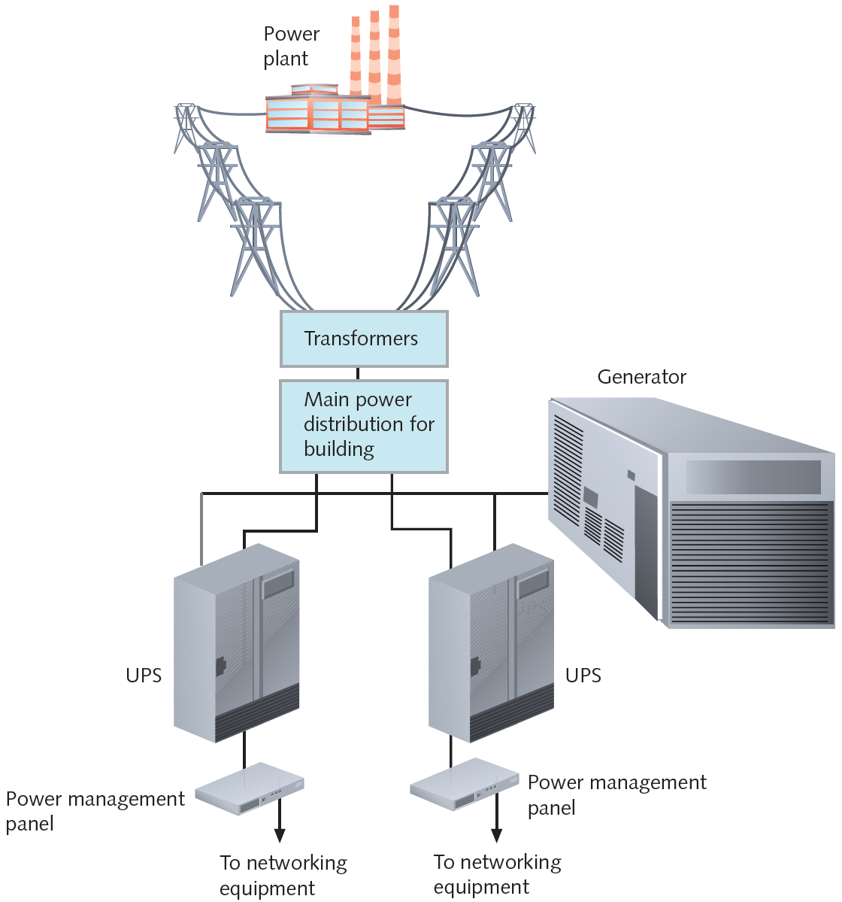

Slide 14
Network Design
What is a good design?
What do you want to achieve?
Keep it as simple as possible!

Slide 15
Scenario…Redundancy
Possible solutions: supply duplicate connection
  Use different service carriers
  Use two different routes
    Critical data transactions follow more than one path
Network redundancy advantages
  Reduces network fault risk
    Lost functionality, profits
Disadvantage: cost

Slide 16
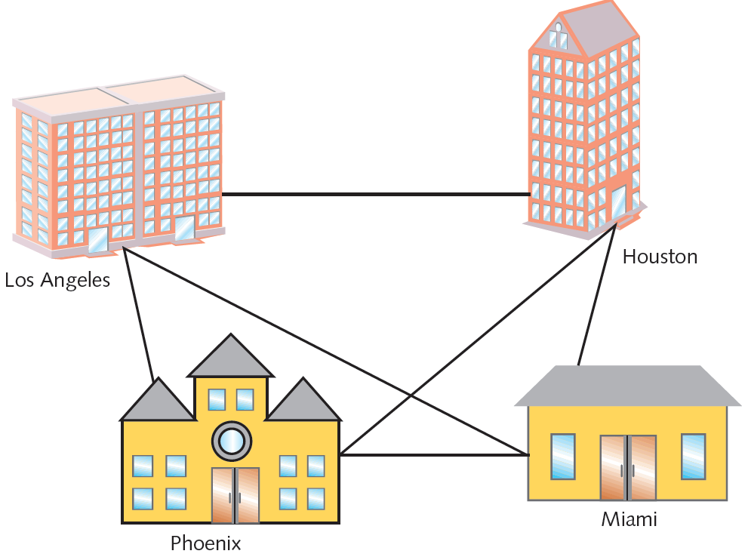
Scenario…Redundancy

Slide 17
Scenario…Critcial Links
Scenario: two critical links
  Capacity, scalability concerns
  Solution
    Partner with ISP
    Establish secure VPNs

Slide 18
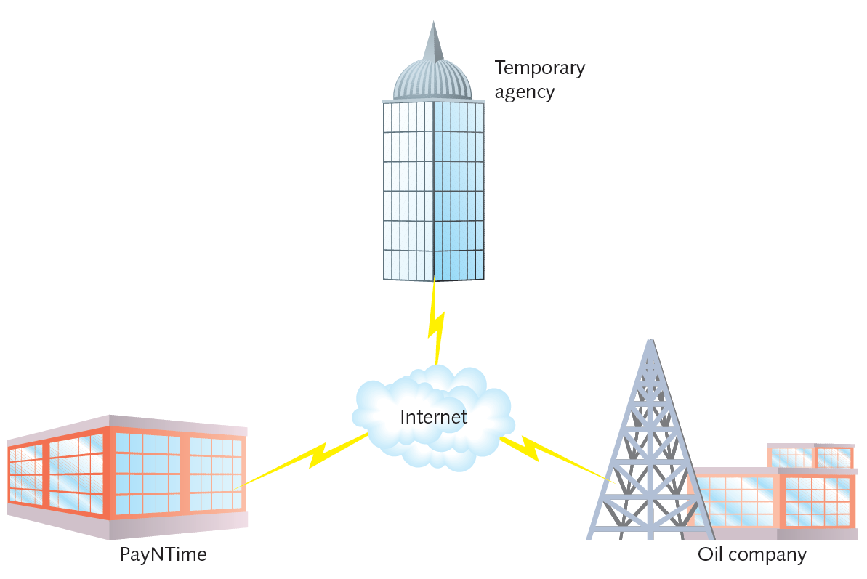

Slide 19
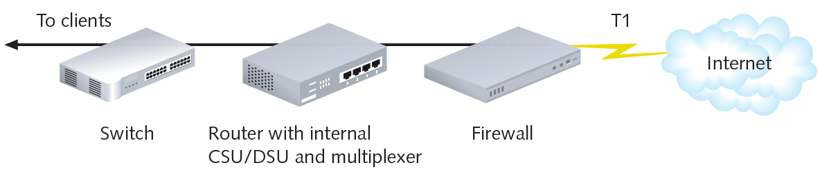
Scenario…Critical Links
Scenario
  Devices connect one LAN, WAN segment to another
    Experience a fault
  VPN agreement with national ISP
    Single T1 link supports five customers

Slide 20
Scenario…Critical Links
Problem with arrangement in previous slide…
  Many single points of failure
    T1 link failure
    Firewall, router, CSU/DSU, multiplexer, or switch
Solution
  Redundant devices with automatic failover
  Hot swappable devices
    Immediately assume identical component duties
Cold spare
  Duplicate device on hand, not installed

Slide 21
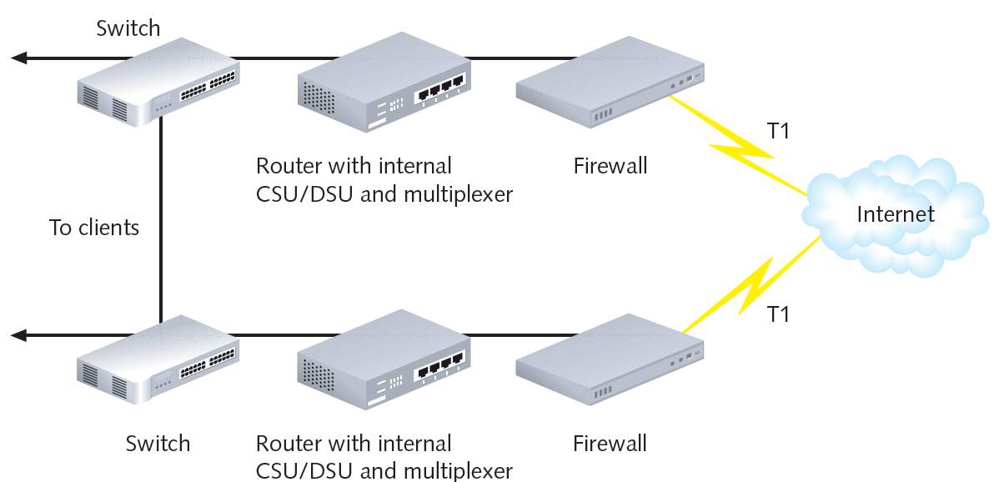

Slide 22
Servers
Critical servers
  Contain redundant components
    Provide fault tolerance, load balancing
Server mirroring
  Fault-tolerance technique
  One device, component duplicates another's activities
  Uses identical servers, components
  High-speed link between servers
  Synchronization software
  Form of replication
    Dynamic copying of data from one location to another

Slide 23
Storage
Data storage
  Issues of availability and fault tolerance apply
Various methods available
  Ensure shared data and applications never lost or irretrievable
RAID (Redundant Array of Independent [or Inexpensive] Disks)
  Collection of disks
  Provide shared data, application fault tolerance

Slide 24
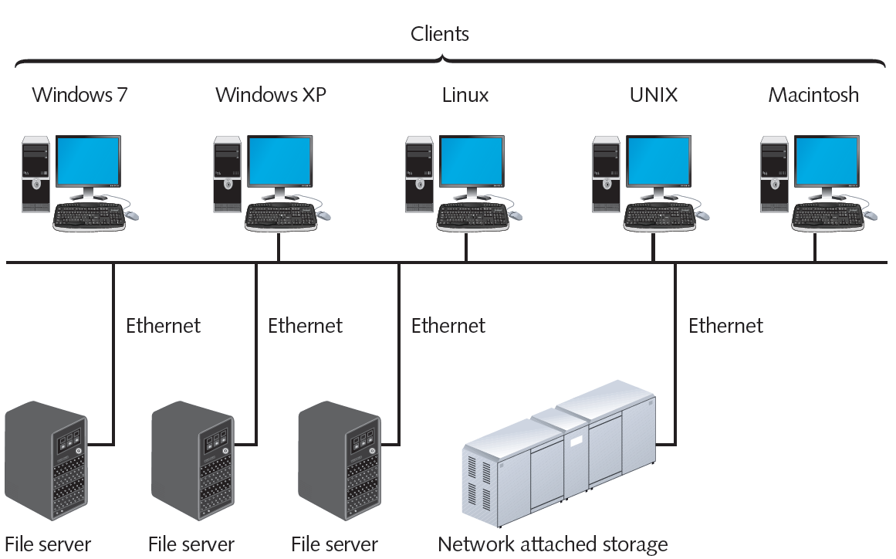
Network attached storage on a LAN

Slide 25
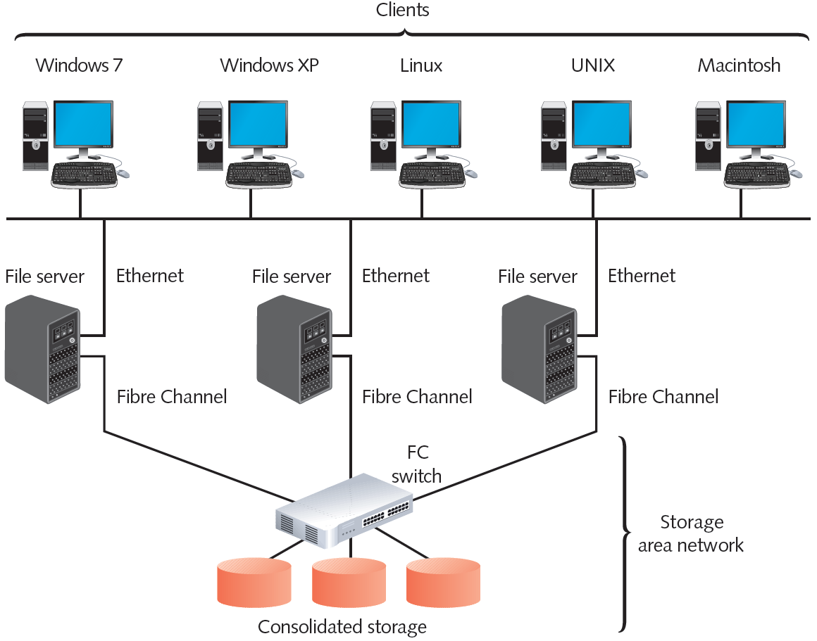
Storage Area Network

Slide 26
Data Backup
Backup
  Copies of data or program files
  Created for archiving, safekeeping
  Store off site
Without backup: risk losing everything
Many backup options available
  Performed by different software and hardware
  Use different storage media types
Can be controlled by NOS utilities, third-party software

Slide 27
Backup Media and Methods
Approach to selecting backup media, methods
  Ask questions to select appropriate solution
Optical media
  Media storing digitized data
  Uses laser to write data, read data
  Examples: CDs, DVDs, Tape
Backup requirements
  Recordable CD or DVD drive, software utility
Blu-ray
  Optical storage format

Slide 28
Backup Media and Methods
DVD and Blu-ray DVD disadvantages
  Writing data takes longer than other media
  Requires more human intervention than other backup methods
Tape backups
  Copying data to magnetic tape
Requirements
  Tape drive connected to network
  Management software
  Backup media

Slide 29
Backup Media and Methods
External disk drives (removable disk drives)
  Storage device attached temporarily to computer
    USB, PCMCIA, FireWire, CompactFlash port
  Simple to use, save, share data
  Temporary drive appears like any other drive
Large data amount requirements
  Backup control features, higher storage capacity, faster read-write access

Slide 30
Backup Media and Methods
Network backups
  Save data to another place on network
  Different server, another WAN location
  SAN, NAS storage device
Online backup (cloud backup)
  Saves data to another company’s storage array using Internet
  Implement strict security measures
  Automated backup, restoration processes
Evaluate online back up provider
  Test speed, accuracy, security, recovery

Slide 31
Backup Strategy
Devise a strategy to perform reliable backups
Document in accessible area
Address various questions
Full backup
  All data copied
Incremental backup
  Copy data changed since last full, incremental backup
Differential backup
  Copy only data changed since last backup

Slide 32
Disaster Recovery
Disaster recovery
  Restoring critical functionality, data
    After enterprise-wide outage
    Affecting more than single system, limited group
Consider possible extremes
  Not relatively minor outages, failures, security breaches, data corruption

Slide 33
Disaster Recovery Planning
Account for worst-case scenarios
Identify disaster recovery team
Provide contingency plans
  Restore and replace:
    Computer systems
    Power
    Telephony systems
    Paper-based files
Plan contains various sections
Lessen critical data loss risk

Slide 34
Disaster Recovery Contingencies
Cold site
  Components necessary to rebuild network exist
  Not appropriately configured, updated, or connected
Warm site
  Components necessary to rebuild network exist
  Some appropriately configured, updated, and connected
Hot site
  Components exist and match network’s current state
  All appropriately configured, updated, and connected

Slide 35
Fundamentals of Network Management

Slide 36
Fundamentals of Network Management
Network management
  Assess, monitor, and maintain all network aspects
  Scope differs according to network’s size and importance
  Several network management disciplines
  All share same goals
    Enhance efficiency and performance
    Prevent costly downtime and loss
  Predict problems before they occur

Slide 37
Documentation
Network aspects to document
  Physical topology
  Access method
  Protocols
  Devices
  Operating systems
  Applications
  Configurations

Slide 38
Documentation Set
Configuration management
  Collection, storage, assessment of configuration documentation
Documenting all network aspects
  Saves future work
Network diagrams
  Graphical representations of network’s devices, connections
  Use popular Cisco icons
  Provide broad snapshot of network’s physical or logical topology

Slide 39
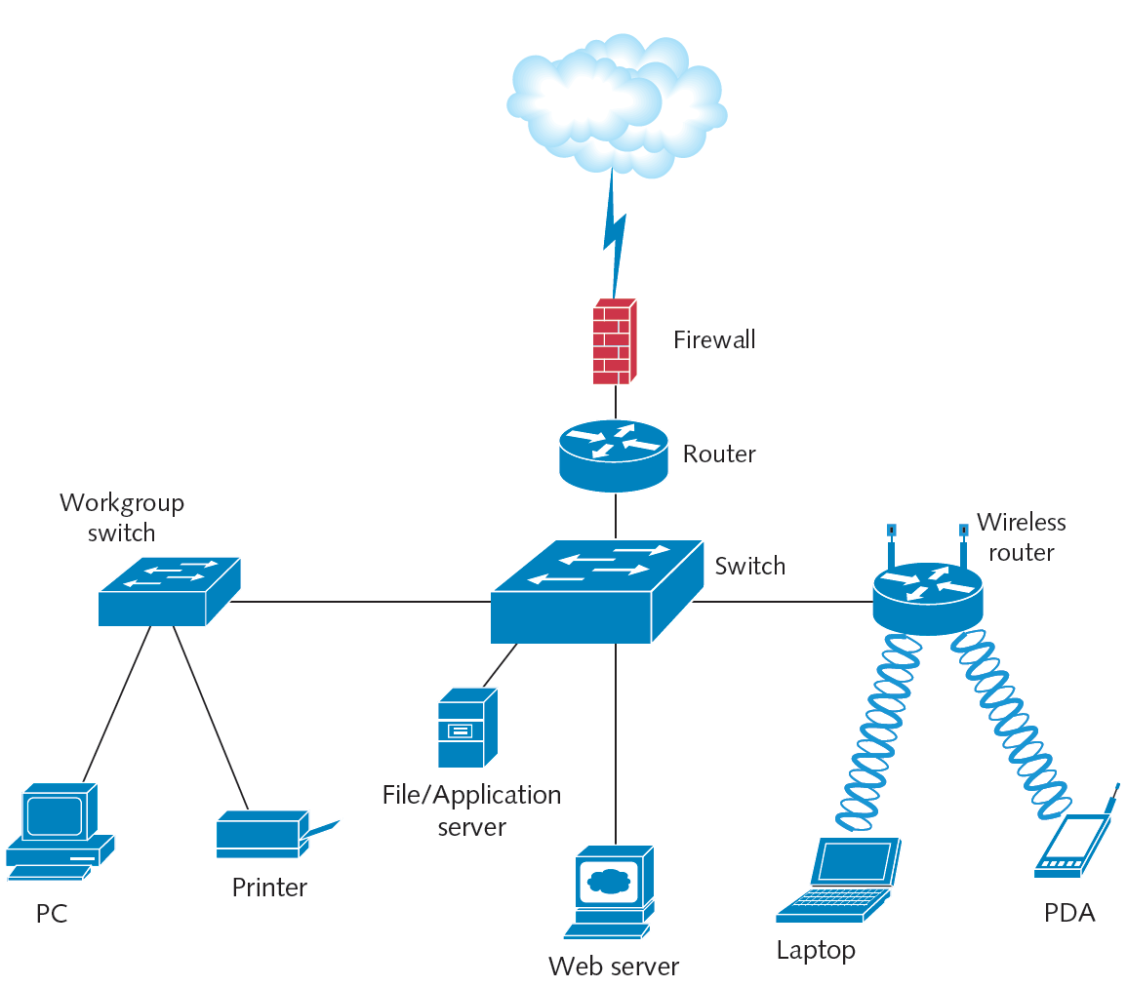

Slide 40
Documentation Set
Wiring schematic
  Graphical representation of network’s wired infrastructure
  Detailed form
    Includes every wire connecting network devices
  Less detailed form
    Single line represents group of wires connecting several clients to a switch

Slide 41
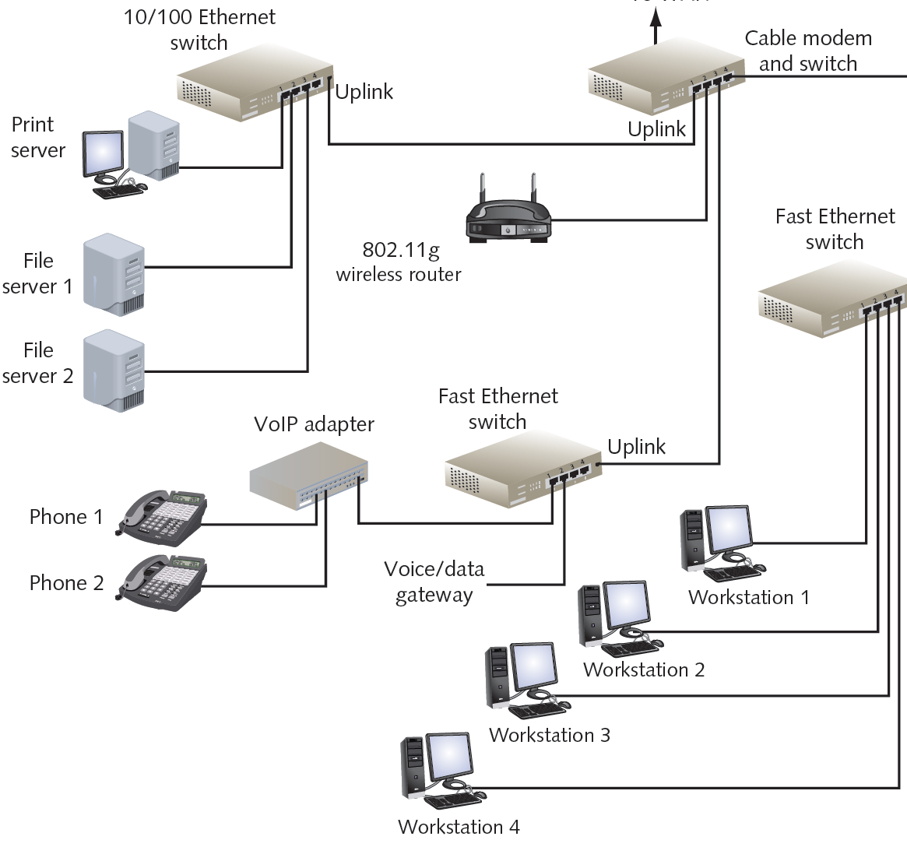

Slide 42
Baseline Measurements
Baseline
  Report of network’s current operation state
Example baseline measurements
  Network backbone utilization rate
  Number of users logged on per day or per hour
  Number of protocols running on network
  Error statistics
    Runts, collisions, jabbers, giants
  Frequency of application use
  Bandwidth usage

Slide 43
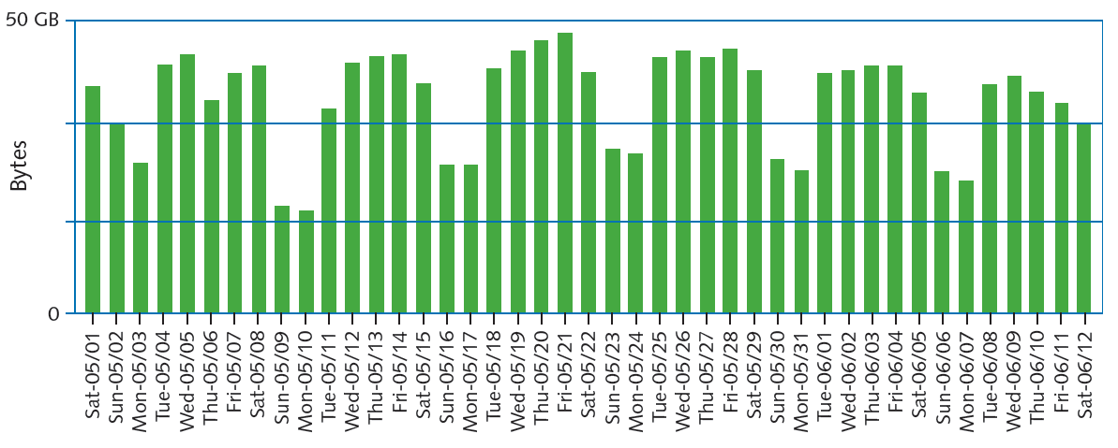

Slide 44
Why Basline?
Compare future and past performance
  Most critical network, user functions
  More data provides more accuracy
Forecasting network traffic patterns
  Difficult to predict users’ habits, new technology effects, changes in resource demand
Gathering baseline data
  Software applications
    Freeware
    Expensive, customizable hardware and software
  Determine use before selecting

Slide 45
Network Management Systems
Enterprise-wide network management systems
  Accomplish fault and performance management
  All use similar architecture
  Polling
    Collecting data from multiple networked devices at regular intervals
  Agent
    Software routine
    Collects information about device’s operation
    Provides information to network management application

Slide 46
Network Management Software
Various aspects of a device can be managed
  Processor, memory, hard disk, NIC, and intangibles
MIB (Management Information Base)
  Contains managed devices definition, data
SNMP (Simple Network Management Protocol)
  Used to communicate managed device information
  Part of TCP/IP suite
  SNMPv3: most secure version of the protocol
  SNMPv2 still widely used

Slide 47
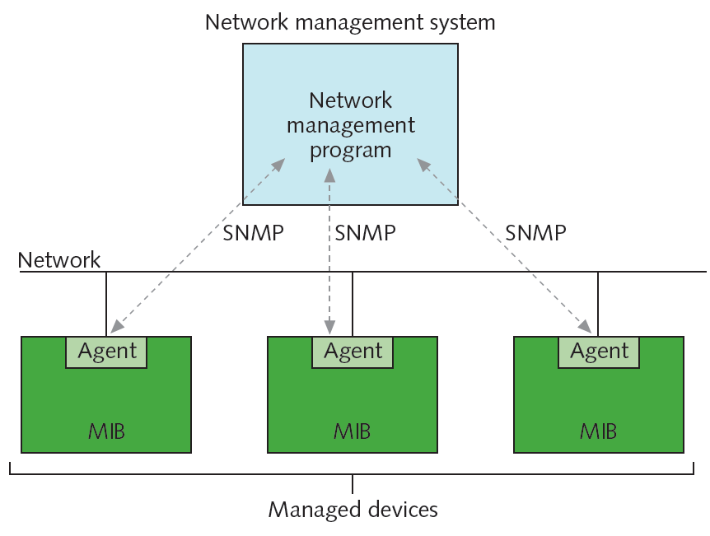

Slide 48
Network Management Software
Several ways to view and analyze data
Network management applications
  Flexible
  Challenging to configure and fine-tune
  Choose correct type and amount of information to collect
Faults can trigger alarms
  Also recorded in system and event logs

Slide 49
