Slide 1
NETWORKING BASICS

Slide 2
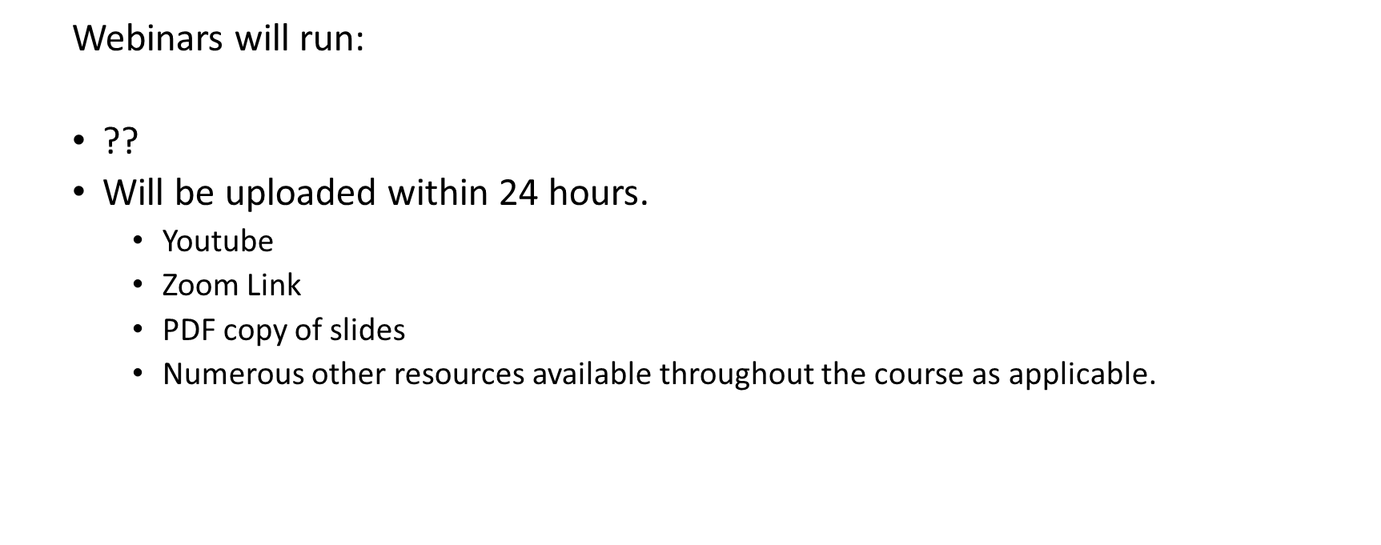
Class Times

Slide 3
Outline
Explain the purposes and uses of ports & protocols.
Explain devices, applications, protocols and services at their appropriate OSI layers.
Explain the concepts and characteristics of routing and switching.
Compare and contrast the characteristics of network topologies, types and technologies.
Given a scenario, implement the appropriate wireless technologies and configurations.
Summarize cloud concepts and their purposes.
Explain the functions of network services.

Slide 4
Network services - the resources a network makes available to its users
  Includes applications and the data provided by these applications
Types of applications found on most networks:
  Client-Server
  File and Print Services
  Communications Services

Slide 5
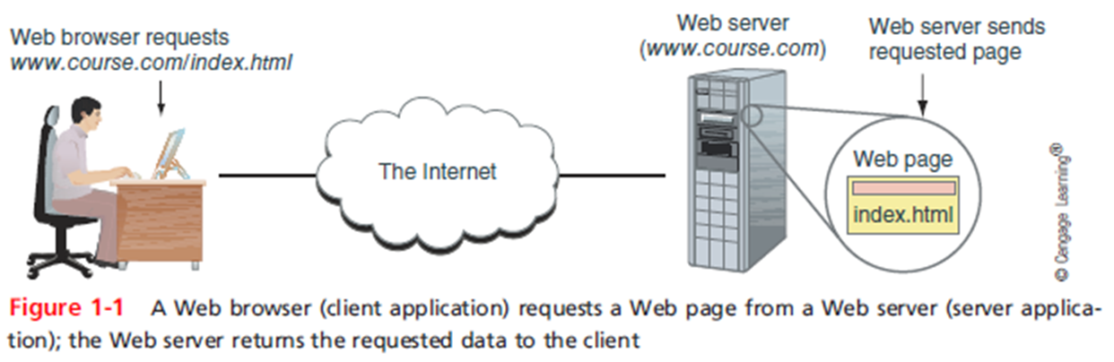
Client computer requests data or a service from a second computer, called the server
List of several popular client-server applications:
  Web service
  Email services
  FTP service
  Telnet service
  Remote Desktop
  Remote applications

Slide 6
File services - a server’s ability to share data files and disk storage space
File server - a computer that provides file services
Print services - ability to share printers across a network
  With one printer, less time is spent on maintenance and management

Slide 7
Communication Services
Convergence - using the same network to deliver multiple types of
communications services
Unified communication (UC) - refers to the centralized management
of multiple network-based communications
Three types of communication services:
  Conversational voice - VoIP (Voice over IP)
  Streaming live audio and video
  Streaming stored audio and video
Voice and video transmissions are delay-sensitive
Voice and video transmission are considered loss-tolerant
Network administrators must pay attention to the quality of service (QoS) a network provides for voice and video
Bandwidth - the amount of traffic, or data transmission activity, on the network

Slide 8
Controlling Network Access
Topology - how parts of a whole work together
Physical topology - mostly applies to hardware and describes how computers, other devices, and cables fir together to form the physical network
Logical topology - has to do with software and describes how access to the network is controlled
  How users and programs initially gain access to the network
Network operating system - controls access to the entire network
  Required by client-server models

Slide 9
Peer-to-Peer Model
Peer-to-peer (P2P) network model - the OS of each computer on the network is responsible for controlling access to its resources
  No centralized control
Computers, called nodes or hosts, form a logical group of computers and users
  May share resources
  May prevent access to resources
Each computer user has a Windows local account
  Works only on that one computer

Slide 10
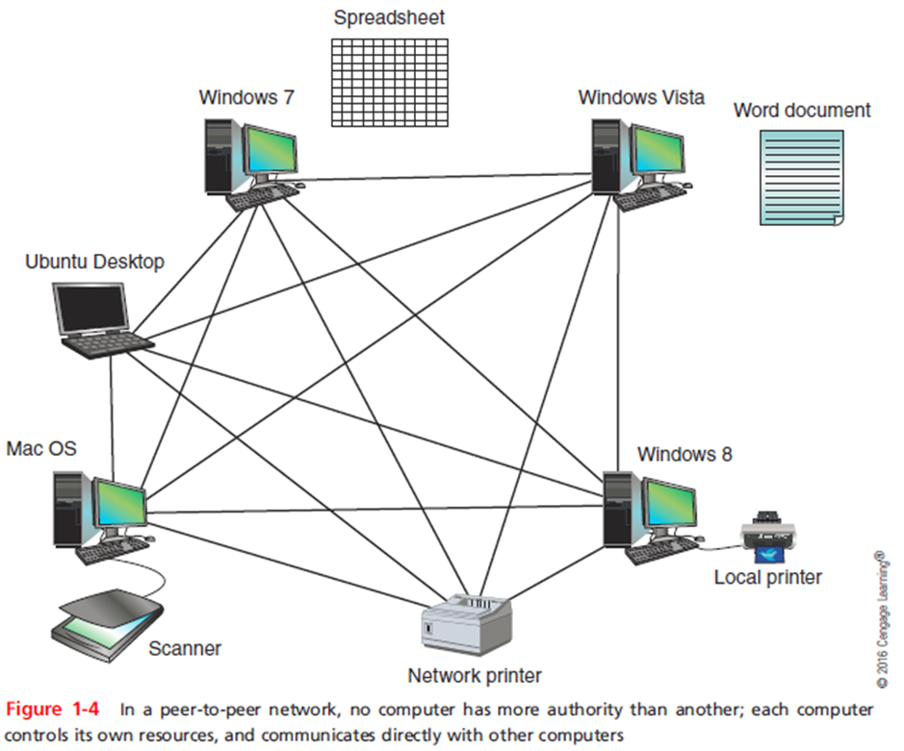
Peer-to-Peer Model
Advantages
  Simple configuration
  Less expensive
    Compared to other network models
Disadvantages
  Not scalable
  Not necessarily secure
  Not practical for large installations

Slide 11
Client-Server Network Model
Resources are managed by the network operating system (NOS) via a centralized directory database
Windows domain - a logical group of computers that a Windows Server can control
Active Directory (AD) - the centralized directory database that contains user account information and security for the entire group of computers
Global account (a.k.a. global username or network ID) - a domain-level account assigned by the network administrator and is kept in AD
A user can sign on to the network from any computer on the network and gain access to the resources that AD allows
  This process is managed by Active Directory Domain Services (AD DS)
Clients don’t share their resources directly with each other
  Access is controlled by entries in the centralized domain database

Slide 12
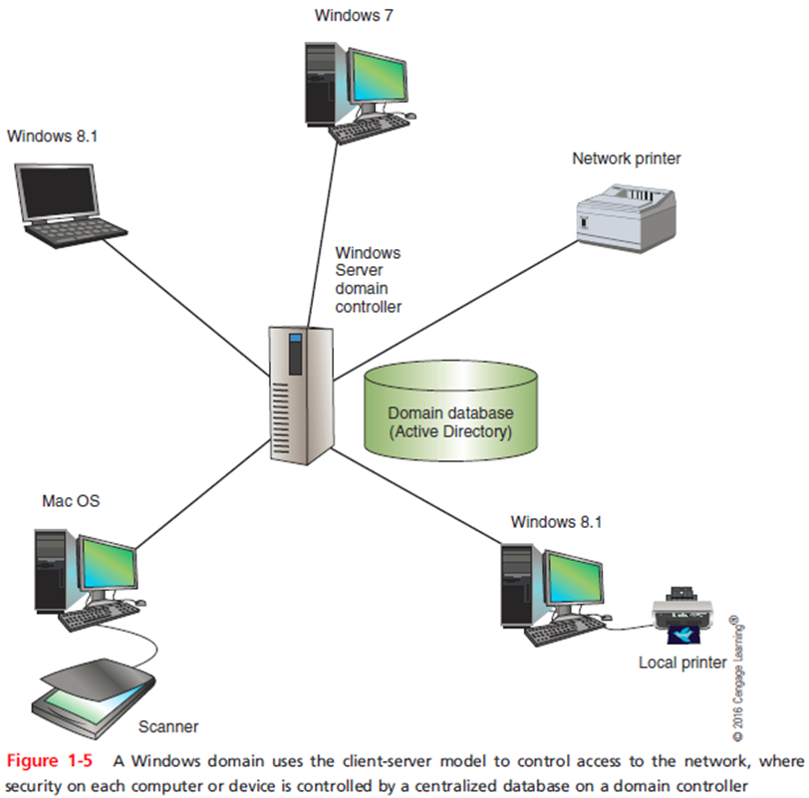
Client-Server Network Model
The NOS is responsible for:
  Manages client data, resources
  Ensures authorized user access
  Controls user file access
  Restricts user network access
  Dictates computer communication rules
  Supplies application to clients
Server examples
  Windows Server 2012 R2, Ubuntu Server, etc.
Servers that have a NOS installed require:
  More memory, processing, storage capacity
Advantages relative to peer-to-peer networks
  User credential assigned from one place
  Multiple shared resource access centrally controlled
  Central problem monitoring, diagnostics, correction capabilities
  More scalable

Slide 13
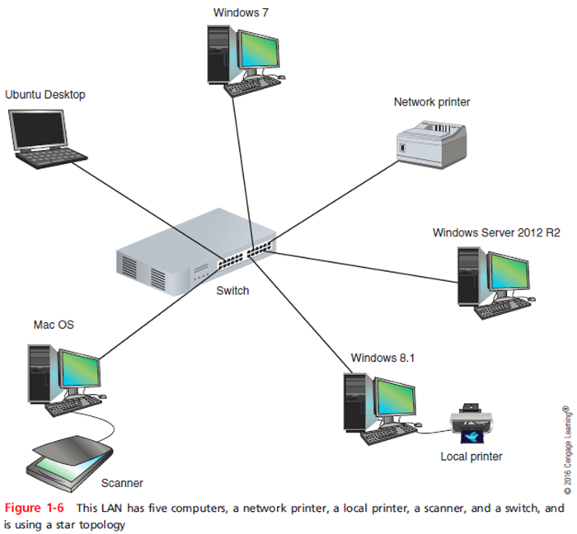
Networking Hardware and Physical Topologies

Slide 14
LANs and Their Hardware
Local area network (LAN) - usually contained in a small space
  Such as an office or building
Switch - receives incoming data from one of its ports and redirects it to another port or multiple ports
  Will send the data to its intended destination
Star topology - all devices connect to one central device (usually a switch)
Network interface card (NIC) - a network port used to attach a device to a network
A LAN can have several switches
Backbone - a central conduit that connects the segments (pieces) of a network
  Might use higher transmission speeds and different cabling than network cables connected to computers
Three switches daisy-chained together in a single line is said to use a bus topology
  However, each switch is connected to computers via a star topology, making it a star-bus topology
  A topology that combines topologies is known as a hybrid topology

Slide 15
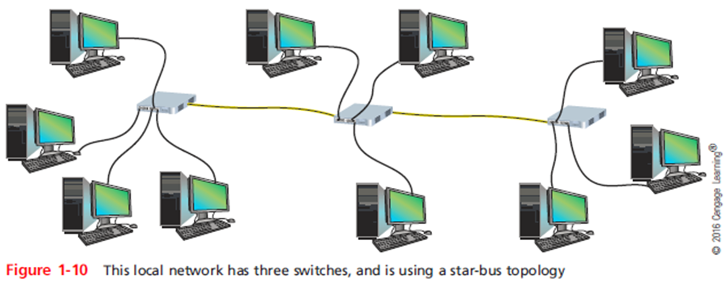
LANs and Their Hardware

Slide 16
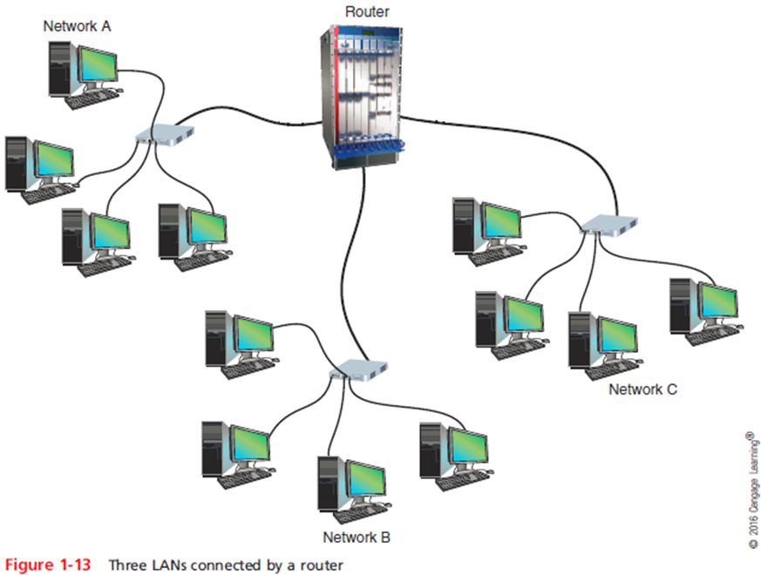
LANs and Their Hardware
Router - a device that manages traffic between two or more networks
  Can help find the best path for traffic to get from one network to another
Routers can be used in small home networks to connect the home LAN to the Internet
Industrial-grade routers can have several network ports, one for each network it connects to
Difference between router and switch:
  Router is like a gateway between networks

Slide 17
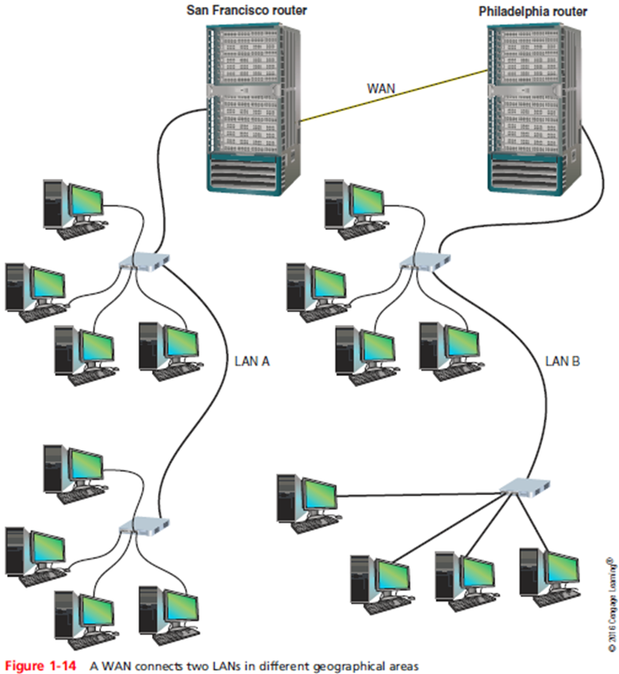
MANs and WANs
Metropolitan area network (MAN) - a group of connected LANs in the same geographical area
  Also known as a campus area network (CAN)
WAN (wide area network) - a group of LANs that spread over a wide geographical area
  Internet is the largest and most varied WAN
MANs and WANs often use different transmission
methods and media than LANs
PAN (personal area network) - smallest network
  A network of personal devices

Slide 18
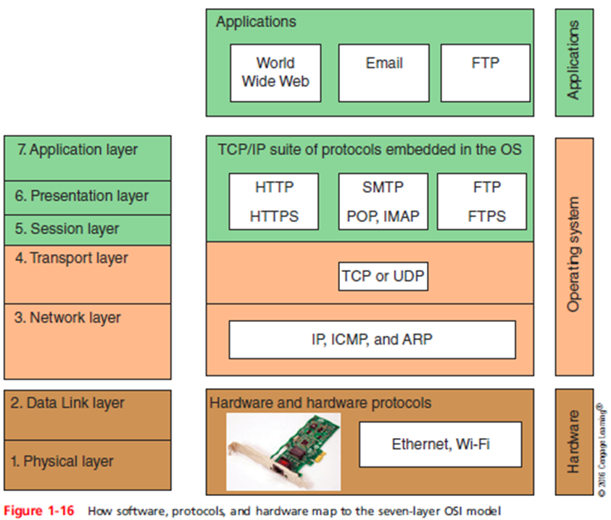
The Seven-Layer OSI Model
OSI (Open Systems Interconnection) reference model - a seven-layer model developed to categorize the layers of communication
“Open systems” – equates to interoperability of different systems – not reliant upon architecture or hardware
Developed by ISO in the 1980s
The layers are numbered in order, starting with Layer 1, the Physical layer at the bottom
  Physical,
  Data Link,
  Network,
  Transport,
  Session,
  Presentation,
  Application

Slide 19
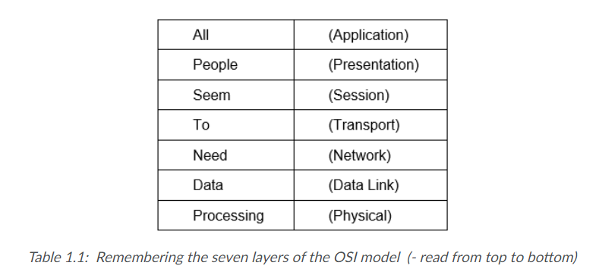
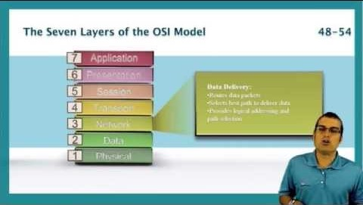
Watch
Watch this video for further insight into OSI model. [9:41 min].
StormWind Studios. (2011, May 16). OSI model [Video file].Retrieved from https://youtu.be/aDyMEDeh94I

Slide 20
Layer 7: Application Layer
Application layer - describes the interface between two applications, on separate computers
Application layer protocols are used by programs that fall into two categories:
  Provide services to a user, such as a browser and Web server
  Utility programs that provide services to the system, such as SNMP that monitor and gather information about network traffic
Payload - data that is passed between applications or utility programs and the OS
Notes:
Layer 7: Application Layer
Application layer - describes the interface between two applications, on separate computers
Application layer protocols are used by programs that fall into two categories:
Provide services to a user, such as a browser and Web server
Utility programs that provide services to the system, such as SNMP that monitor and gather information about network traffic
Payload - data that is passed between applications or utility programs and the OS

Slide 21
Layer 6: Presentation Layer
Presentation layer - responsible for reformatting, compressing, and/or encrypting data in a way that the receiving application can read
Example:
  An email message can be encrypted at the Presentation layer by the email client or by the OS
Notes:
Layer 6: Presentation Layer
Presentation layer - responsible for reformatting, compressing, and/or encrypting data in a way that the receiving application can read
Example:
An email message can be encrypted at the Presentation layer by the email client or by the OS

Slide 22
Layer 5: Session Layer
Session layer - describes how data between applications is synched and recovered if messages don’t arrive intact at the receiving application
The Application, Presentation, and Session layers are intertwined
  Often difficult to distinguish between them
Most tasks are performed by the OS when an application makes an API call to the OS
  Application programming interface (API) call is the method an application uses when it makes a request of the OS
Notes:
Layer 5: Session Layer
Session layer - describes how data between applications is synched and recovered if messages don’t arrive intact at the receiving application
The Application, Presentation, and Session layers are intertwined
Often difficult to distinguish between them
Most tasks are performed by the OS when an application makes an API call to the OS
Application programming interface (API) call is the method an application uses when it makes a request of the OS

Slide 23
Layer 4: Transport Layer
Transport layer - responsible for transporting Application layer payloads from one application to another
Two main Transport layer protocols are:
  TCP (Transmission Control Protocol) - makes a connection with the end host, checks whether data was received; called a connection-oriented protocol
  UDP (User Datagram Protocol) - does not guarantee delivery by first connecting and checking whether data is received; called a connectionless protocol
Notes:
Layer 4: Transport Layer
Transport layer - responsible for transporting Application layer payloads from one application to another
Two main Transport layer protocols are:
TCP (Transmission Control Protocol) - makes a connection with the end host, checks whether data was received; called a connection-oriented protocol
UDP (User Datagram Protocol) - does not guarantee delivery by first connecting and checking whether data is received; called a connectionless protocol

Slide 24
Layer 4: Transport Layer
Protocols add their own control information in an area at the beginning of the payload (called a header)
Encapsulation - process of adding a header to the data inherited from the layer above
The Transport layer header addresses the receiving application by a number called a port number
If message is too large, TCP divides it into smaller messages called segments
  In UDP, the message is called a datagram
Notes:
Layer 4: Transport Layer
Protocols add their own control information in an area at the beginning of the payload (called a header)
Encapsulation - process of adding a header to the data inherited from the layer above
The Transport layer header addresses the receiving application by a number called a port number
If message is too large, TCP divides it into smaller messages called segments
In UDP, the message is called a datagram

Slide 25
Layer 3: Network Layer
Network layer - responsible for moving messages from one node to another until reaches destination
IP adds its own Network layer header to the segment or datagram
  The entire Network layer message is called a packet
IP address - assigned to each node on a network
  Network layer uses it to uniquely identify each host
IP relies on several routing protocols to find the best route for a packet to take to reach destination
  ICMP and ARP are examples
Notes:
Layer 3: Network Layer
Network layer - responsible for moving messages from one node to another until reaches destination
IP adds its own Network layer header to the segment or datagram
The entire Network layer message is called a packet
IP address - assigned to each node on a network
Network layer uses it to uniquely identify each host
IP relies on several routing protocols to find the best route for a packet to take to reach destination
ICMP and ARP are examples

Slide 26
Layer 2: Data Link Layer
Layers 2 and 1 are responsible for interfacing with physical hardware on the local network
  Protocols at these layers are programmed into firmware of a computer’s NIC and other hardware
Type of networking hardware or technology used on a network determine the Link Layer protocol used
  Ethernet and Wi-Fi are examples
The Link layer puts control information in a Link layer header and at the end of the packet in a trailer
  Entire Link layer is called a frame
Notes:
Layer 2: Data Link Layer
Layers 2 and 1 are responsible for interfacing with physical hardware on the local network
Protocols at these layers are programmed into firmware of a computer’s NIC and other hardware
Type of networking hardware or technology used on a network determine the Link Layer protocol used
Ethernet and Wi-Fi are examples
The Link layer puts control information in a Link layer header and at the end of the packet in a trailer
Entire Link layer is called a frame

Slide 27
Layer 2: Data Link Layer
MAC (Media Access Control) address - hardware address of the source and destination NICs
  Also called a physical address, hardware address, or Data Link layer address
  Embedded on every network adapter and are considered short-range addresses that can only find nodes on the local network
Notes:
Layer 2: Data Link Layer
MAC (Media Access Control) address - hardware address of the source and destination NICs
Also called a physical address, hardware address, or Data Link layer address
Embedded on every network adapter and are considered short-range addresses that can only find nodes on the local network

Slide 28
Layer 1: Physical Layer
Physical layer - simplest layer and is responsible for sending bits via a wired or wireless transmission
Can be transmitted as:
  Wavelengths in the air
  Voltage on a copper wire
  Light (via fiber-optic cabling)
Notes:
Layer 1: Physical Layer
Physical layer - simplest layer and is responsible for sending bits via a wired or wireless transmission
Can be transmitted as:
Wavelengths in the air
Voltage on a copper wire
Light (via fiber-optic cabling)

Slide 29
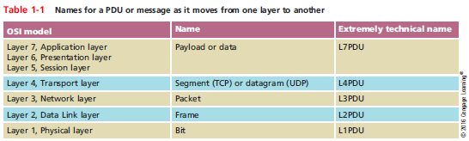
Protocol Data Unit or PDU
Protocol data unit (PDU) - the technical name for a group of bits as it moves from one layer to the next and from one LAN to the next
  Technicians loosely call this group of bits a message or a transmission
Notes:
Protocol Data Unit or PDU
Protocol data unit (PDU) - the technical name for a group of bits as it moves from one layer to the next and from one LAN to the next
Technicians loosely call this group of bits a message or a transmission

Slide 30
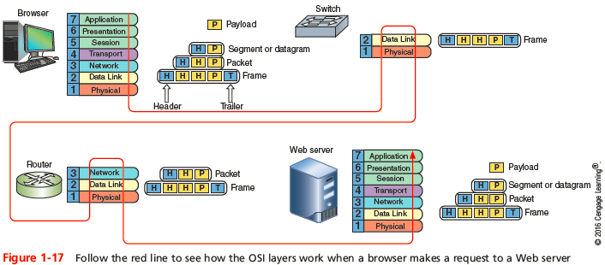
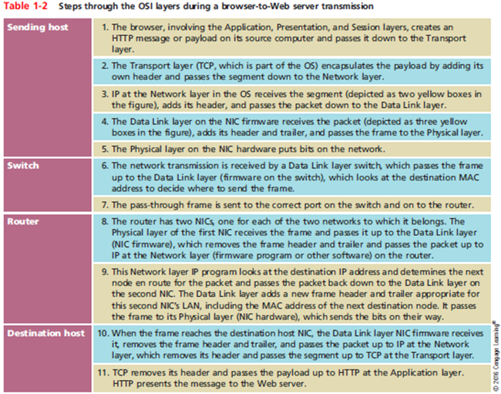
Summary of How the Layers Work Together
Notes:
Summary of How the Layers Work Together

Slide 31
Tips:
- All nodes in a network need to have the network layer, only the two end computers need to have the transport layer
Notes:
Summary of How the Layers Work Together

Slide 32
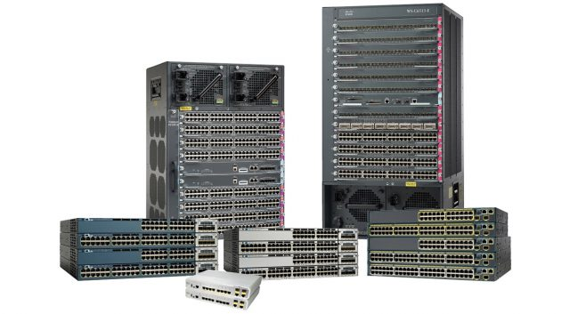
Switches
Connectivity devices that subdivide a network
  Segments
Traditional switches
  Operate at Data Link OSI model layer
Modern switches
  Can operate at Layer 3 or Layer 4
Switches interpret MAC address information
Common switch components
  Internal processor, operating system, memory, ports

Slide 33
Switch Installation
Follow manufacturer’s guidelines
General steps (assume Cat 5 or better UTP)
  Verify switch placement
  Turn on switch
  Verify lights, self power tests
  Configure (if necessary)
  Connect NIC to a switch port (repeat for all nodes)
  After all nodes connected, turn on nodes
  Connect switch to larger network (optional)

Slide 34
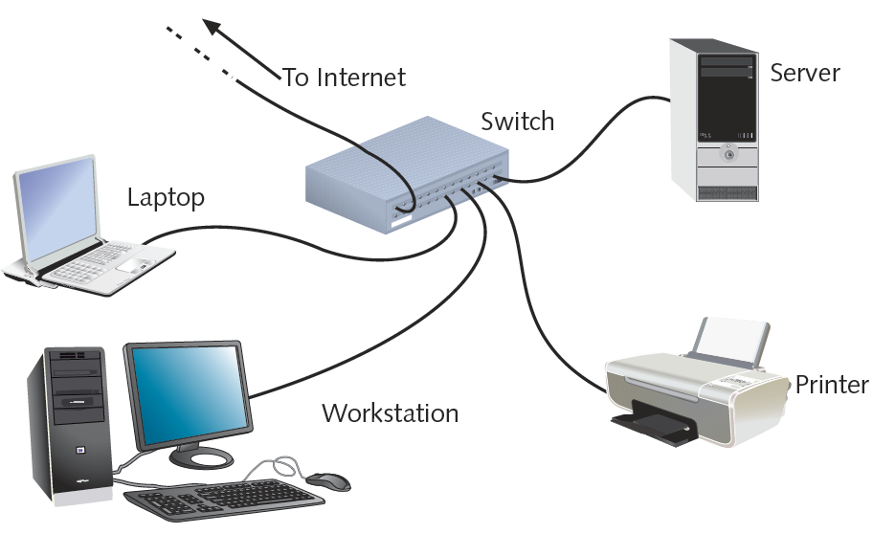
Switch Installation (cont’d.)

Slide 35
Switching Methods
Difference in switches
  Incoming frames interpretation
  Frame forwarding decisions making
Four switching modes exist
  Two basic methods discussed
    Cut-through mode
    Store-and-forward mode

Slide 36
Switching Methods (cont’d.)
Cut-through mode
  Switch reads frame’s header
  Forwarding decision made before receiving entire packet
    Uses frame header: first 14 bytes contains destination MAC address
  Cannot verify data integrity using frame check sequence
  Can detect erroneously shortened packets (runts)
  Runt detected: wait for integrity check

Slide 37
Switching Methods (cont’d.)
Cut-through mode (cont’d.)
  Cannot detect corrupt packets
  Advantage: speed
  Disadvantage
    Data buffering (switch flooded with traffic)
  Best use
    Small workgroups needing speed
    Low number of devices

Slide 38
Switching Methods (cont’d.)
Store-and-forward mode
  Switch reads entire data frame into memory
  Checks for accuracy before transmitting information
  Transmit data more accurately than cut-through mode
  Slower than cut-through mode
  Best uses
    Larger LAN environments; mixed environments
  Can transfer data between segments running different transmission speeds

Slide 39
VLANs and Trunking
VLANs (virtual local area networks)
  Logically separate networks within networks
    Groups ports into broadcast domain
Broadcast domain
  Port combination making a Layer 2 segment
  Ports rely on Layer 2 device to forward broadcast frames
Collision domain
  Ports in same broadcast domain
    Do not share single channel

Slide 40
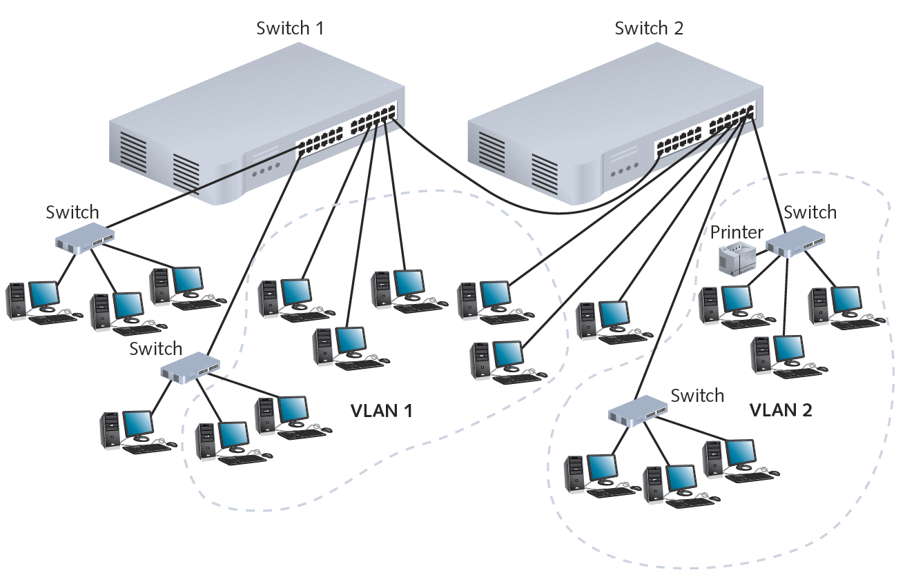

Slide 41
VLANs and Trunking (cont’d.)
Advantage of VLANs
  Flexible
    Ports from multiple switches or segments
    Use any end node type
  Reasons for using VLAN
    Separating user groups
    Isolating connections
    Identifying priority device groups
    Grouping legacy protocol devices
    Separating large network into smaller subnets

Slide 42
VLANs and Trunking (cont’d.)
Switch typically preconfigured
  One default VLAN
  Cannot be deleted or renamed
Create additional VLANs
  Indicate to which VLAN each port belongs
  Additional specifications
    Security parameters, filtering instructions, port performance requirements, network addressing and management options
Maintain VLAN using switch software

Slide 43
VLANs and Trunking (cont’d.)
Potential problem
  Cutting off group from rest of network
    Correct by using router or Layer 3 switch
Trunking
  Switch’s interface carries traffic of multiple VLANs
Trunk
  Single physical connection between switches
VLAN data separation
  Frame contains VLAN identifier in header

Slide 44
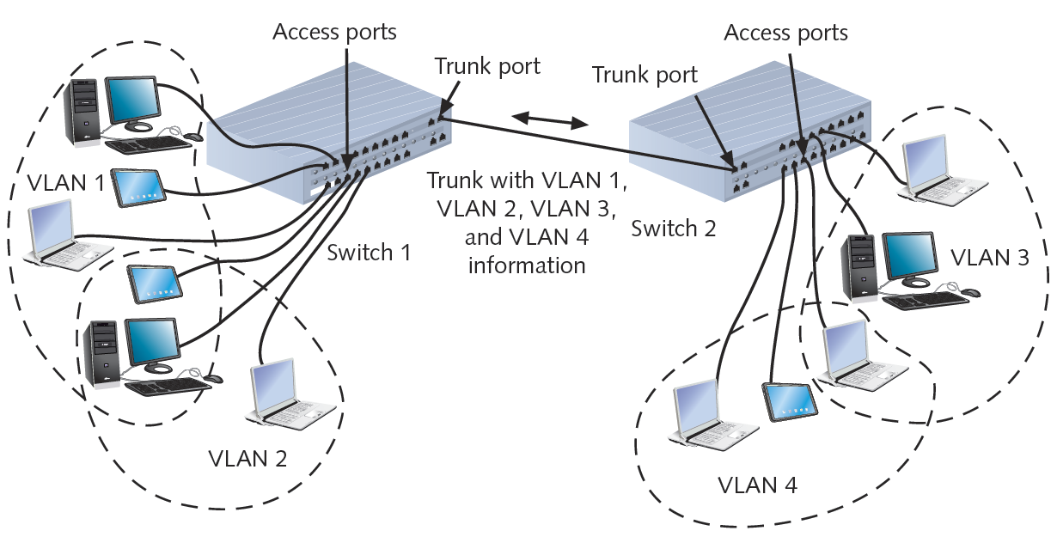
VLANs and Trunking (cont’d.)

Slide 45
STP (Spanning Tree Protocol)
IEEE standard 802.1D
Operates in Data Link layer
Prevents traffic loops
  Calculating paths avoiding potential loops
  Artificially blocking links completing loop
Three steps
  Select root bridge based on Bridge ID
  Examine possible paths between network bridge and root bridge
  Disables links not part of shortest path

Slide 46
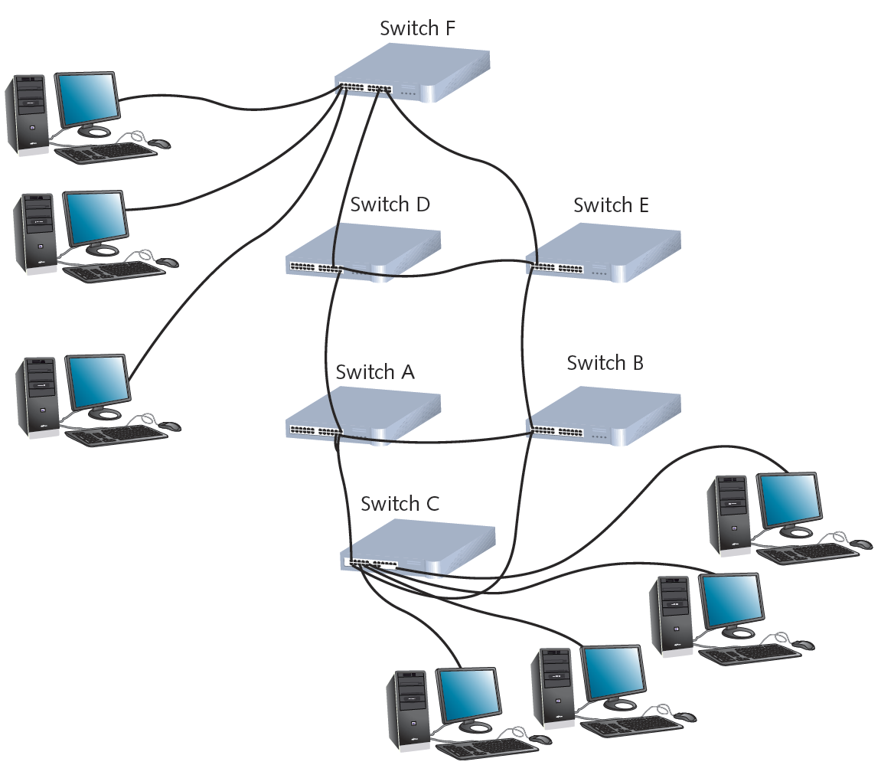

Slide 47
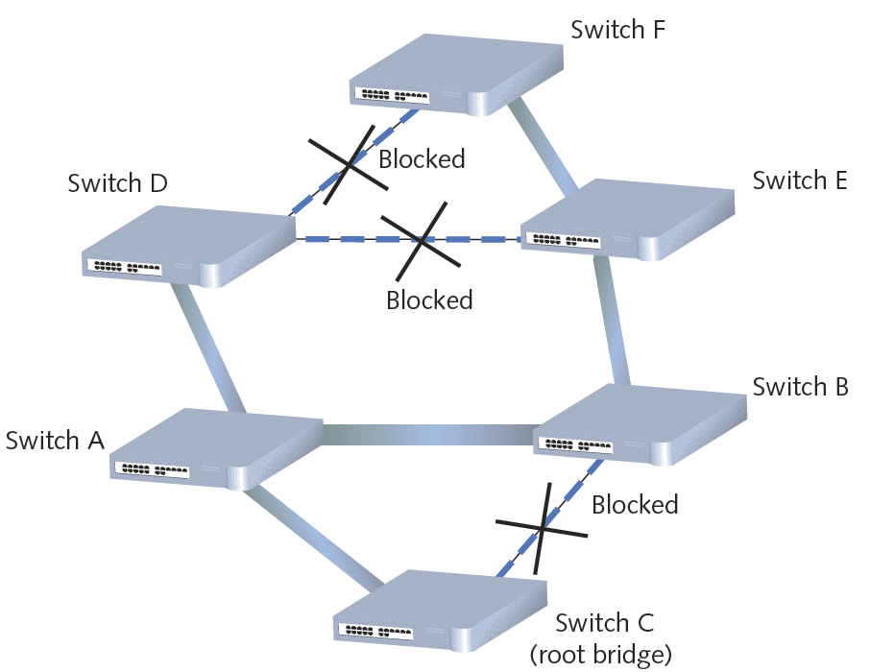

Slide 48
STP (cont’d.)
History
  Introduced in 1980s
    Original STP too slow
  RSTP (Rapid Spanning Tree Protocol)
    Newer version
    IEEE’s 802.1w standard
Cisco and Extreme Networks
  Proprietary versions
No enabling or configuration needed
  Included in switch operating software

Slide 49
Content and Multilayer Switches
Layer 3 switch (routing switch)
  Interprets Layer 3 data
Layer 4 switch
  Interprets Layer 4 data
Content switch (application switch)
  Interprets Layer 4 through Layer 7 data
Advantages
  Advanced filtering
  Keeping statistics
  Security functions

Slide 50
Content and Multilayer Switches (cont’d.)
Distinguishing between Layer 3 and Layer 4 switch
  Manufacturer dependent
Higher-layer switches
  Cost more than Layer 2 switches
  Used in network backbone

Slide 51
Routers
Multiport connectivity device
  Directs data between network nodes
  Integrates LANs and WANs
    Different transmission speeds, protocols
Operate at Network layer (Layer 3)
  Directs data from one segment or network to another
  Logical addressing
  Protocol dependent
Slower than switches and bridges
  Need to interpret Layers 3 and higher information

Slide 52
Routers (cont’d.)
Traditional stand-alone LAN routers
  Being replaced by Layer 3 routing switches
New niche
  Specialized applications
    Linking large Internet nodes
    Completing digitized telephone calls

Slide 53
Router Characteristics and Functions
Intelligence
  Tracks node location
  Determine shortest, fastest path between two nodes
  Connects dissimilar network types
Large LANs and WANs
  Routers indispensable
Router components
  Internal processor, operating system, memory, input and output jacks, management control interface

Slide 54
Router Characteristics and Functions (cont’d.)
Multiprotocol routers
  Multiple slots
  Accommodate multiple network interfaces
Inexpensive routers
  Home, small office use

Slide 55
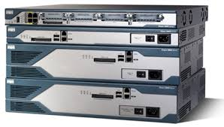
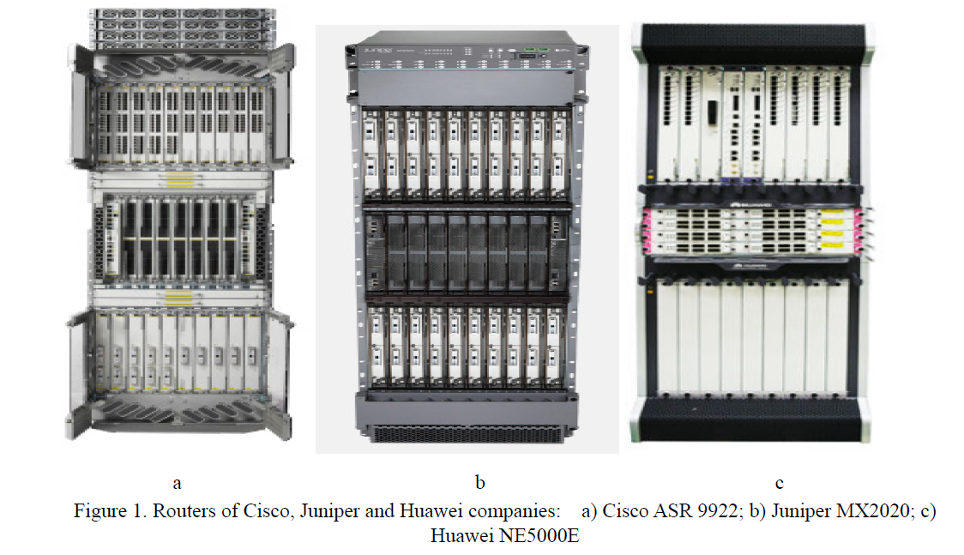
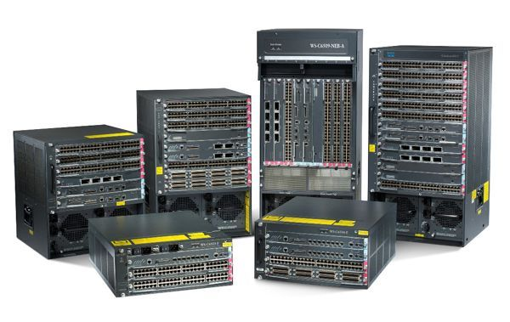

Slide 56
Router Characteristics and Functions (cont’d.)
Router capabilities
  Connect dissimilar networks
  Interpret Layer 3 addressing
  Determine best data path
  Reroute traffic

Slide 57
Router Characteristics and Functions (cont’d.)
Optional router functions
  Filter broadcast transmissions
  Enable custom segregation, security
  Support simultaneous connectivity
  Provide fault tolerance
  Monitor network traffic
  Diagnose problems and trigger alarms

Slide 58
Router Characteristics and Functions (cont’d.)
Interior router
  Directs data between nodes on a LAN
Exterior router
  Directs data between nodes external to a LAN
Border routers
  Connect autonomous LAN with a WAN
Routing tables
  Identify which routers serve which hosts

Slide 59
Router Characteristics and Functions (cont’d.)
Static routing
  Router configured to use specific path between nodes
Dynamic routing
  Automatically calculates best path between nodes
Installation
  Simple for small office or home office LANs
    Web-based configuration
  Challenging for sizable networks

Slide 60
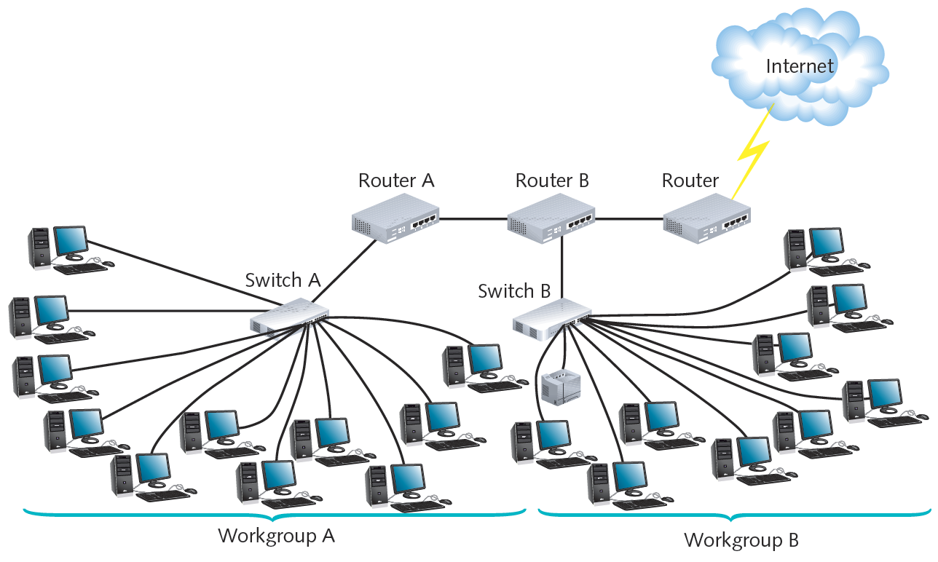

Slide 61
Routing Protocols
Best path
  Most efficient route from one node to another
  Dependent on:
    Hops between nodes
    Current network activity
    Unavailable link
    Network transmission speed
    Topology
  Determined by routing protocol

Slide 62
Routing Protocols (cont’d.)
Routing metric factors
  Number of hops
  Throughput on potential path
  Delay on a potential path
  Load (traffic)
  Maximum transmission unit (MTU)
  Cost
  Reliability of potential path

Slide 63
Routing Protocols (cont’d.)
Router convergence time
  Time router takes to recognize best path
    Change or network outage event
  Distinguishing feature
    Overhead; burden on network to support routing protocol

Slide 64
Routing Protocols (cont’d.)
Distance-vector routing protocols
  Determine best route based on distance to destination
  Factors
    Hops, latency, network traffic conditions
RIP (Routing Information Protocol)
  Only factors in number of hops between nodes
    Limits 15 hops
  Type of IGP (Interior Gateway Protocol)
    Can only route within internal network
  Slower and less secure than other routing protocols

Slide 65
Routing Protocols (cont’d.)
RIPv2 (Routing Information Protocol Version 2)
  Generates less broadcast traffic, more secure
  Cannot exceed 15 hops
  Less commonly used
BGP (Border Gateway Protocol)
  Communicates using BGP-specific messages
  Many factors determine best paths
  Configurable to follow policies
  Type of EGP (Exterior Gateway Protocol)
  Most complex (choice for Internet traffic)

Slide 66
Routing Protocols (cont’d.)
Link-state routing protocol
  Routers share information
    Each router independently maps network, determines best path
OSPF (Open Shortest Path First)
  Interior or border router use
  No hop limit
  Complex algorithm for determining best paths
  Each OSPF router
    Maintains database containing other routers’ links

Slide 67
Routing Protocols (cont’d.)
IS-IS (Intermediate System to Intermediate System)
  Codified by ISO
  Interior routers only
  Supports two Layer 3 protocols
    IP
    ISO-specific protocol
  Less common than OSPF

Slide 68
Routing Protocols (cont’d.)
Hybrid
  Link-state and distance-vector characteristics
  EIGRP (Enhanced Interior Gateway Routing Protocol)
    Most popular
    Cisco network routers only
  EIGRP benefits
    Fast convergence time, low network overhead
    Easier to configure and less CPU-intensive than OSPF
    Supports multiple protocols
    Accommodates very large, heterogeneous networks

Slide 69
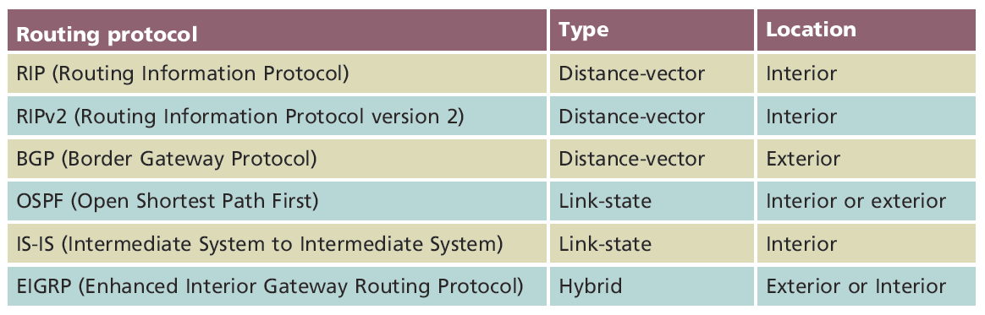
Routing Protocols (cont’d.)

Slide 70
Gateways and Other Multifunction Devices
Gateway
  Combination of networking hardware and software
  Connects two systems using different formatting, communications protocols, architecture
  Repackages information
  Resides on servers, microcomputers, connectivity devices, mainframes
Popular gateways
  E-mail gateway, Internet gateway, LAN gateway, voice/data gateway, firewall

Slide 71
Cloud Computing
Internet frequently pictured as a cloud
Cloud computing
  Flexible provision of data storage, applications, and services
    To multiple clients over a network
Cloud computing distinguishing features
  Self-service and on-demand
  Elastic
  Supports multiple platforms
  Resource pooling and consolidation
  Metered service

Slide 72
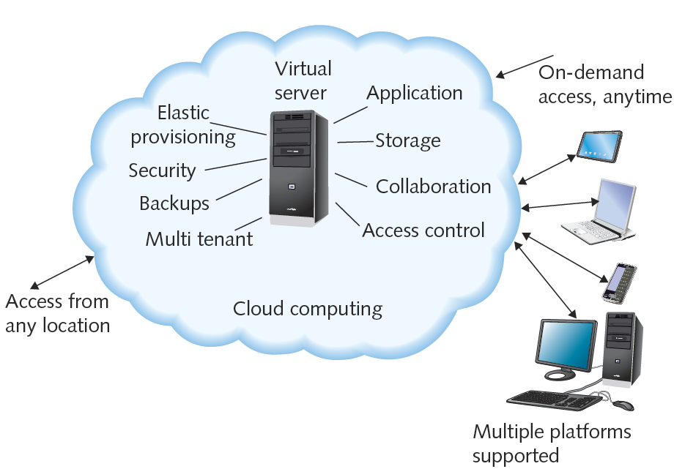
Example of cloud computing

Slide 73
Cloud Computing (cont’d.)
Can provide virtual desktops
  Operating environments hosted virtually
  Different physical computer than one user interacts with
NaaS (Network as a Service)
  Service provider offers customers complete set of networking services
Types of delivery
  Public cloud
  Private cloud

Slide 74
Summary

