Slide 1
IP Addressing

Slide 2
Outline
IP Address Concepts
Private and Public Addresses
Network Address Translation (NAT)
Subnet Mask, Default Gateway
Domain Name Service (DNS)
Troubleshooting Network Connectivity

Slide 3
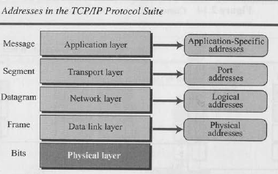

Slide 4
IP Address Concepts
IP Address
  Identifier in IP layer of TCP/IP protocol suite to identify devices connected to the internet
  Unique
  Universal
Address Space – number of addresses used by the protocol
  E.g. the address space of 1Pv4 is 2³² or 4,294,967 ,296.
Notation
  3 common notation for IPv4
    Binary (base 2)
    Dotted-decimal (base 256)
    Hexadecimal (base 16)

Slide 5
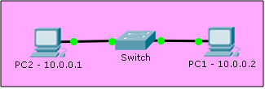
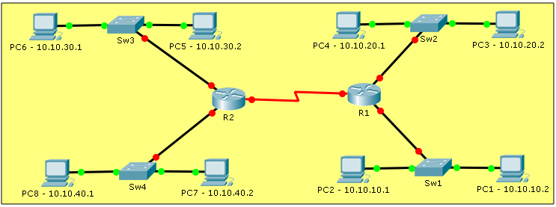
IP Address Concepts
Internet Protocol (IP) Addresses
  Part of the TCP/IP Suite
Assigned to hosts (computers)
Unique in the network

Slide 6
IPv4
IPv4 Address consists of a 32 bit number
  4 octets(8 bits) separated by space or dot
IPv4 Address examples in dotted-decimal notation
  172.20.1.5
  182.56.32.4
  8.8.8.8
Examples in Binary notation (base 2)
  10101100.00010100.00000001.00000101
  10110110.00111000.00100000.00000100
  00001000.00001000.00001000.00001000

Slide 7

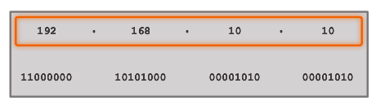


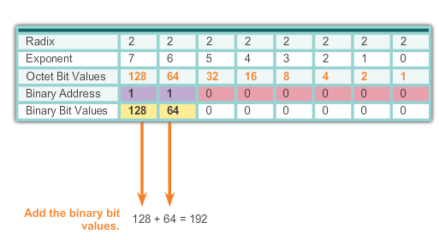
Binary Number System

Slide 8


Binary to Decimal Conversion
Practice

Slide 9
Binary to Decimal Conversion
Practice
Answer = 176
Answer = 255

Slide 10
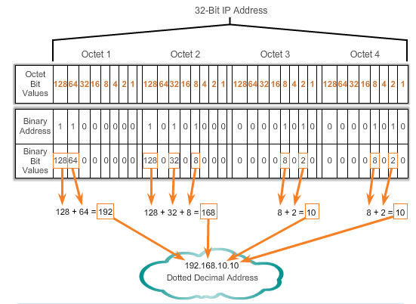
Binary to Decimal Conversion

Slide 11
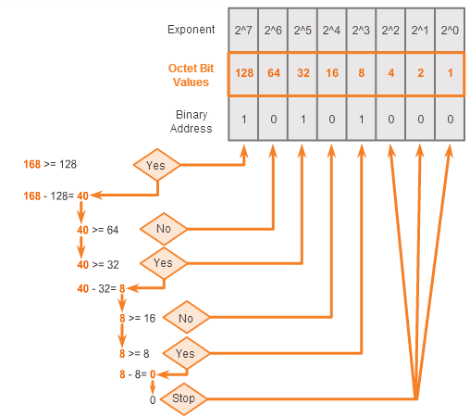
Decimal to Binary Conversion
168 = ? binary

Slide 12
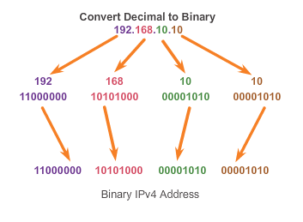
Decimal to Binary Conversion

Slide 13
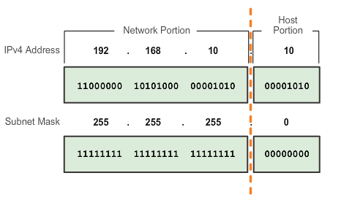
Subnet Mask
To define the network and host portions of an address, a devices use a separate 32-bit pattern called a subnet mask
The subnet mask does not actually contain the network or host portion of an IPv4 address, it just says where to look for these portions in a given IPv4 address

Slide 14
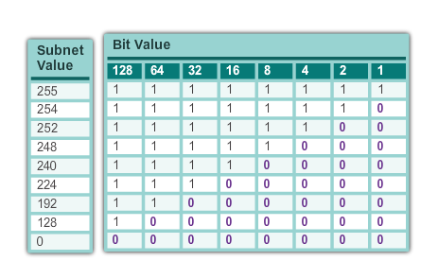
Subnet Mask

Slide 15
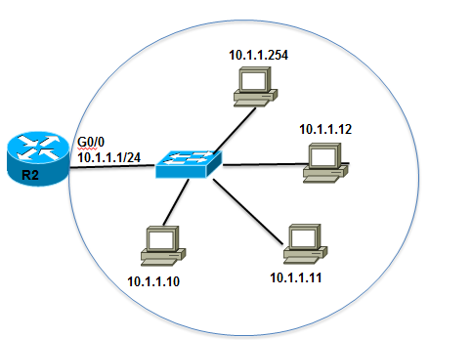
Default Gateway
Default Gateway
  Used to connect hosts to REMOTE networks
  Usually a router/firewall is a default gateway

Slide 16
Public and Private IP Addresses
Private address blocks are:
Hosts that do not require access to the Internet can use private addresses
  10.0.0.0 to 10.255.255.255 (10.0.0.0/8)
  172.16.0.0 to 172.31.255.255 (172.16.0.0/12)
  192.168.0.0 to 192.168.255.255 (192.168.0.0/16)

Slide 17
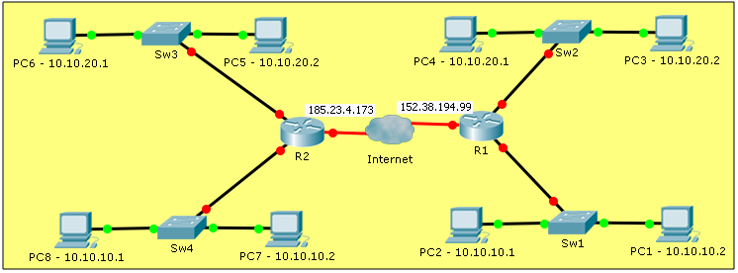
NAT and Private IP Addresses
Private addresses are NOT ROUTED to the internet
Network Address Translation (NAT) needed for internet access

Slide 18
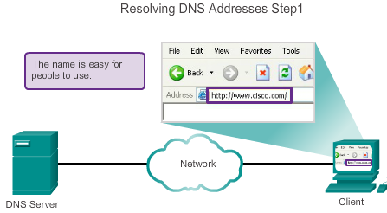
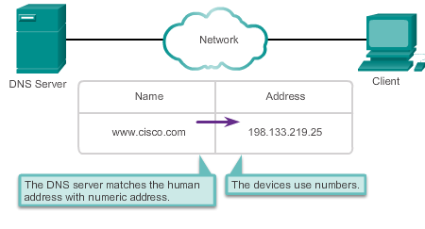
Domain Name Service
A human legible name is resolved to its numeric network device address by the DNS protocol.

Slide 19
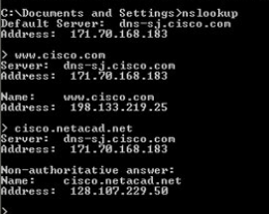
Domain Name Service
Utility called nslookup allows the user to manually query the name servers to resolve a given host name
Utility can be used to troubleshoot name resolution issues and to verify the current status of the name servers

Slide 20
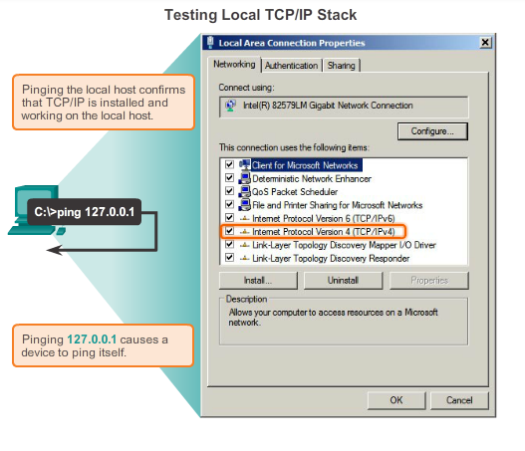
Test Connectivity - PING

Slide 21
Test Connectivity - PING

Slide 22
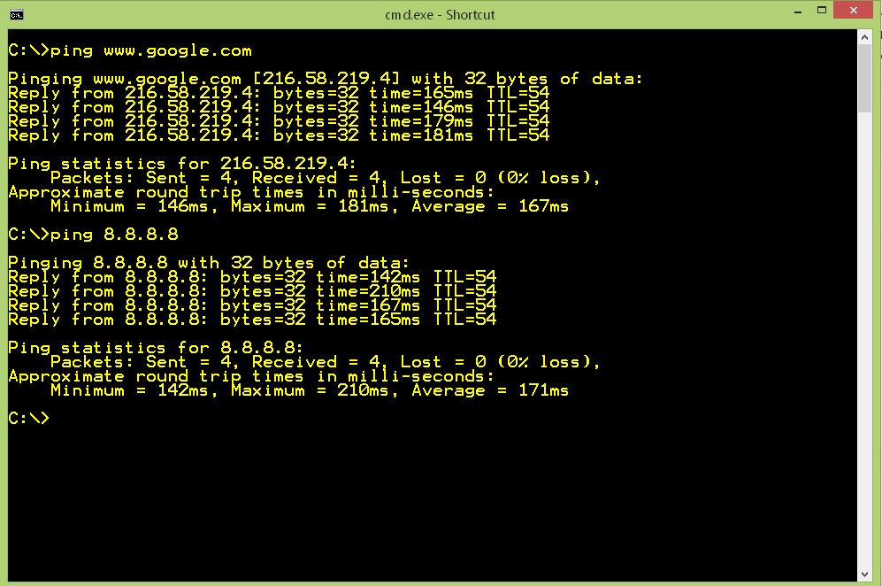
Test Connectivity - PING

Slide 23
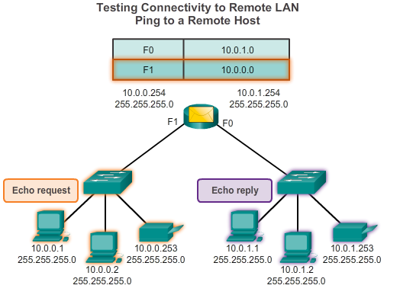
Test Connectivity - PING

Slide 24
Test Path - Traceroute
  Traceroute
  Generates a list of hops that were successfully reached along the path.
  Provides important verification and troubleshooting information.

Slide 25
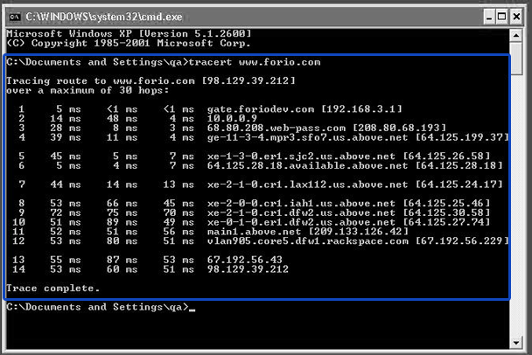
Test Path - Traceroute
  Traceroute

Slide 26
Summary
IP Address Concepts
  32 bits, Unique in the network
Private Addresses
    10.0.0.0/8
    172.16.0.0/12
    192.168.0.0/16
Network Address Translation (NAT)
Subnet Mask, Default Gateway
Domain Name Service (DNS)
  Resolves domain names to IP Addresses
Troubleshooting – ping, tracert

