Slide 1
Network Infrastructure

Slide 2
Overview
Infrastructure
Given a scenario, deploy the appropriate cabling solution.
Given a scenario, determine the appropriate placement of networking devices on a network and install/configure them.
Explain the purposes and use case for advanced networking devices.
Explain the purposes of virtualization and network storage techniques.
Compare and contrast WAN technologies.

Slide 3
Topics
WAN Essentials
Virtualization
VPN

Slide 4
WAN Essentials
WAN
  Network traversing some distance, connecting LANs
  Transmission methods depend on business needs
WAN and LAN common properties
  Client-host resource sharing
  Layer 3 and higher protocols
  Packet-switched digitized data

Slide 5
WAN Essentials
WAN and LAN differences
  Layers 1 and 2 access methods, topologies, media
  LAN wiring: privately owned
  WAN wiring: public through NSPs (network service providers)
    Examples: AT&T, Verizon, Sprint
WAN site
  Individual geographic locations connected by WAN
WAN link
  WAN site to WAN site connection

Slide 6
WAN Topologies
Differences from LAN topologies
  Distance covered, number of users, traffic
  Connect sites via dedicated, high-speed links
    Use different connectivity devices
WAN connections
  Require Layer 3 devices
    Routers
  Cannot carry nonroutable protocols

Slide 7
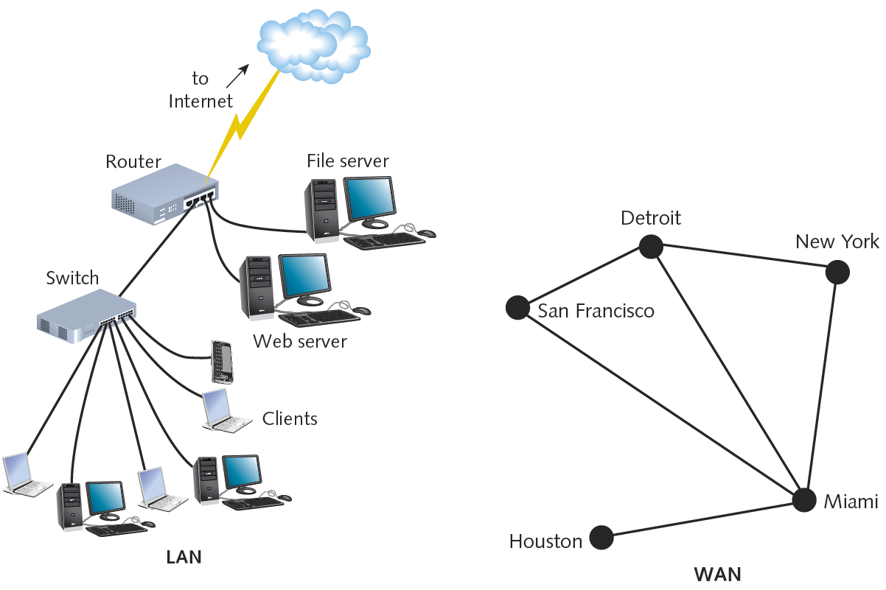

Slide 8
Bus
Bus topology WAN
  Each site connects serially to two sites maximum
  Network site dependent on every other site to transmit and receive traffic
  Different locations connected to another through point-to-point links
Best use
  Organizations requiring small WAN, dedicated circuits
Drawback
  Not scalable

Slide 9
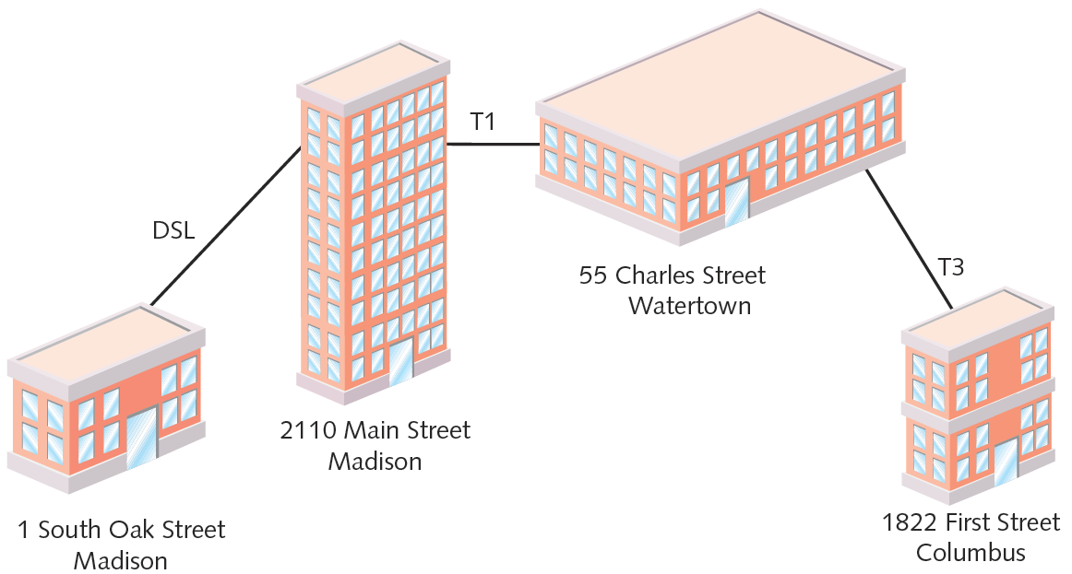

Slide 10
Ring
Ring topology WAN
  Each site connected to two other sites
  Forms ring pattern
  Connects locations
  Relies on redundant rings
    Data rerouted upon site failure
  Expansion
    Difficult, expensive
Best use
  Connecting maximum five locations

Slide 11
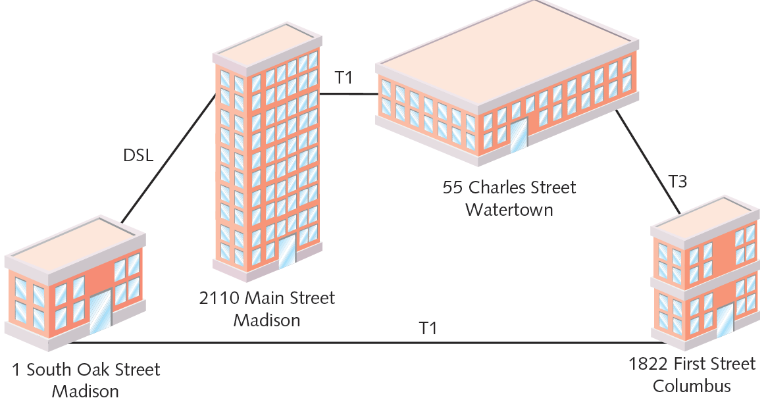

Slide 12
Star
Star topology WAN
  Single site central connection point
  Separate data routes between any two sites
Advantages
  Single connection failure affects one location
  Shorter data paths between any two sites
  Expansion: simple, less costly
Drawback
  Central site failure can bring down entire WAN

Slide 13
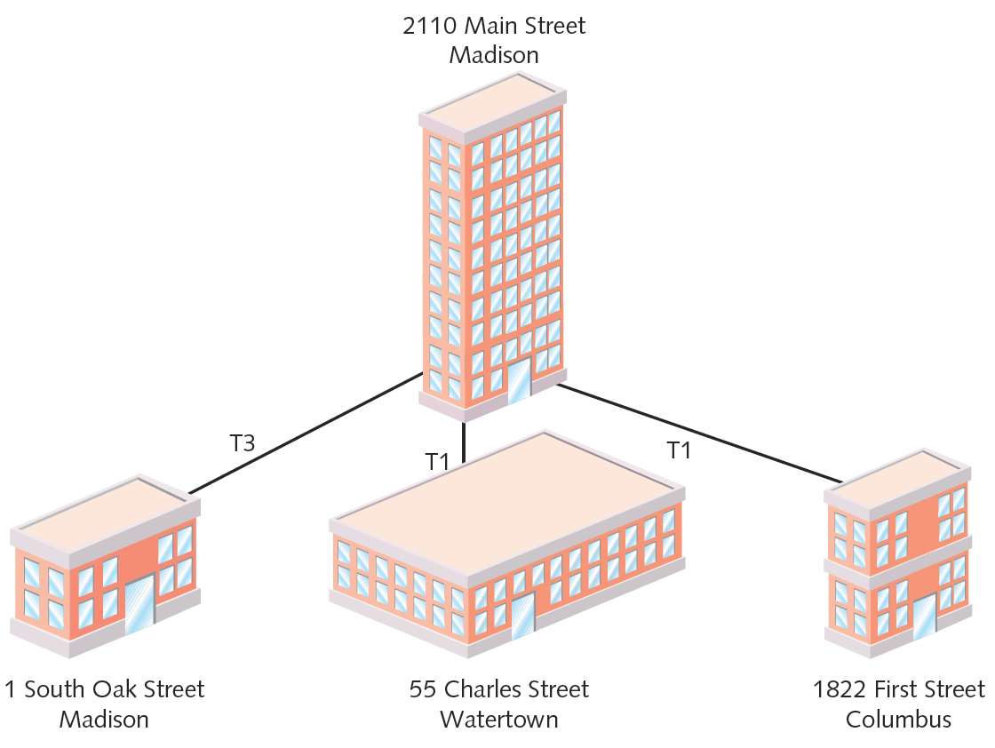

Slide 14
Mesh
Mesh topology WAN
  Incorporates many directly interconnected sites
  Data travels directly from origin to destination
  Routers can redirect data easily, quickly
Most fault-tolerant WAN type
Full-mesh WAN
  Every WAN site directly connected to every other site
  Drawback: cost
Partial-mesh WAN
  Less costly

Slide 15
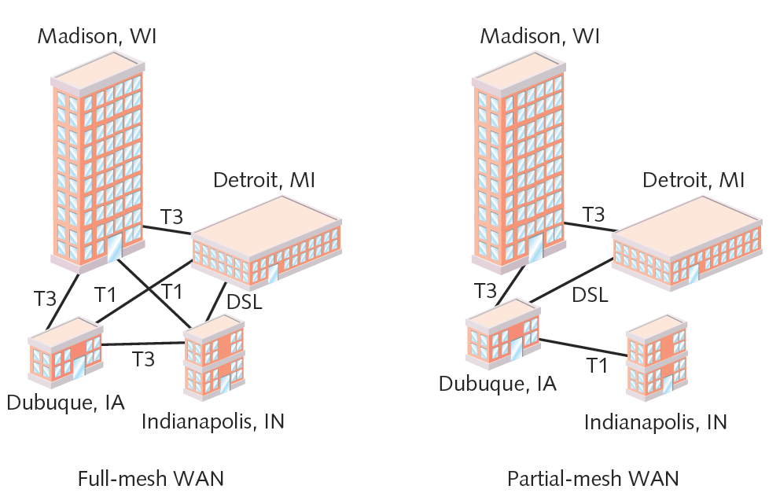

Slide 16
Tiered
Tiered topology WAN
  Sites connected in star or ring formations
    Interconnected at different levels
  Interconnection points organized into layers
    Form hierarchical groupings
Flexibility
  Allows many variations, practicality
  Requires careful considerations
    Geography, usage patterns, growth potential

Slide 17
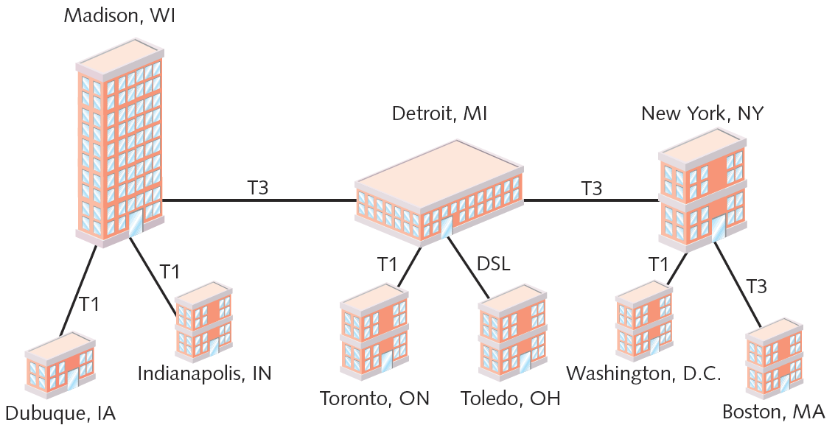

Slide 18
PSTN, X.25 & Frame-Relay
All older style services.
PSTN (Public Switched Telephone Network)
  Dial-up connection
X.25 ITU standard
  Analog, packet-switching technology
    Designed for long distance
  Original standard: mid 1970s
    Mainframe to remote computers: 64 Kbps throughput
  Update: 1992
    2.048 Mbps throughput
    Client, servers over WANs

Slide 19
PSTN, X.25 & Frame-Relay
Frame relay
  Updated X.25: digital, packet-switching
  Protocols operate at Data Link layer
    Supports multiple Network, Transport layer protocols
Both perform error checking
  Frame relay: no reliable data delivery guarantee
  X.25: errors fixed or retransmitted
Throughput
  X.25: 64 Kbps to 45 Mbps
  Frame relay: customer chooses

Slide 20
X.25 & Frame Relay
Both use virtual circuits
  Node connections with disparate physical links
    Logically appear direct
  Advantage: efficient bandwidth use
Both configurable as SVCs (switched virtual circuits)
  Connection established for transmission, terminated when complete
Both configurable as PVCs (permanent virtual circuits)
  Connection established before transmission, remains after transmission

Slide 21
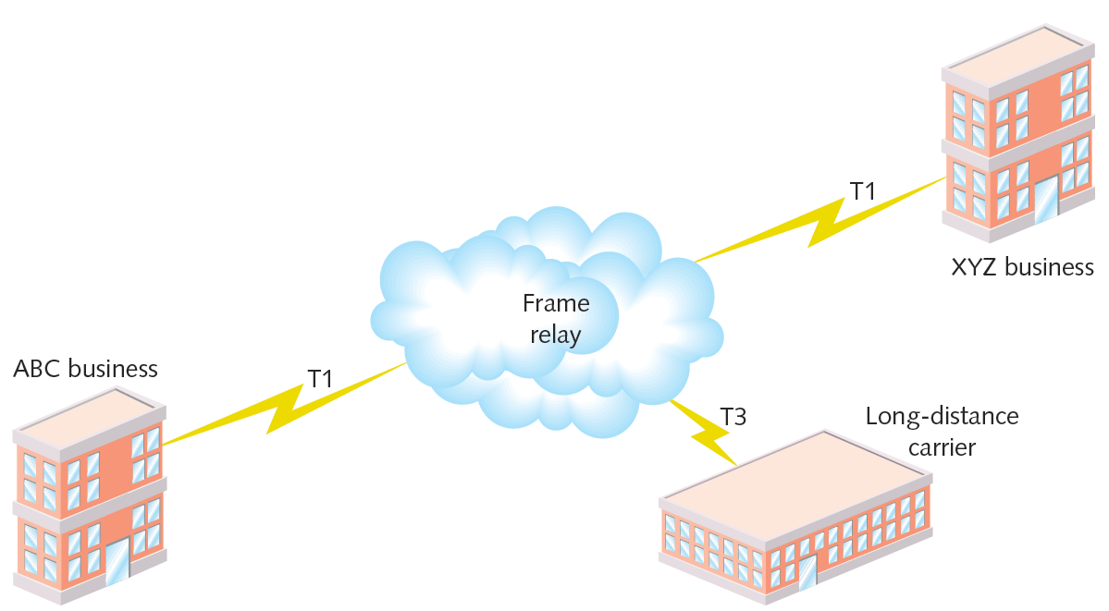

Slide 22
DSL (Digital Subscriber Line)
Operates over PSTN
Requires repeaters for longer distances
Best suited for WAN local loop
Supports multiple data, voice channels
  Over single line
  Higher, inaudible telephone line frequencies
Uses advanced data modulation techniques
  Data signal alters carrier signal properties
  Amplitude or phase modulation

Slide 23
Types of DSL
xDSL refers to all DSL varieties
  ADSL, G.Lite, HDSL, SDSL, VDSL, SHDSL
Two DSL categories
  Asymmetrical and symmetrical
Downstream
  Data travels from carrier’s switching facility to customer
Upstream
  Data travels from customer to carrier’s switching facility

Slide 24
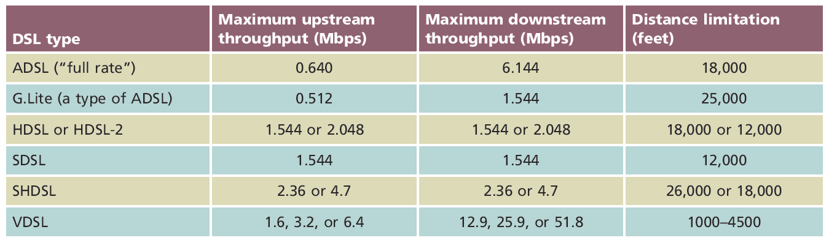
Types of DSL Quick Summary

Slide 25
Broadband Cable
Cable companies connectivity option
Based on TV signals coaxial cable wiring
  Theoretical transmission speeds
    150 Mbps downstream; 10 Mbps upstream
  Real transmission
    10 Mbps downstream; 2 Mbps upstream
    Transmission limited ( throttled)
    Shared physical connections
Best uses
  Web surfing
  Network data download

Slide 26
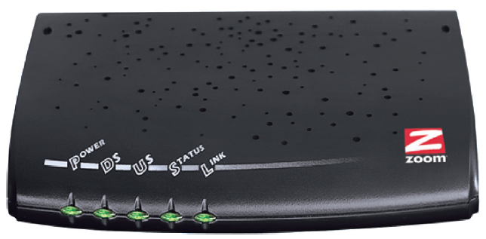
Broadband Cable
Cable modem
  Modulates, demodulates transmission, reception signals via cable wiring
  Operates at Physical and Data Link layer
  May connect to connectivity device
Figure 7-21 A cable modem
Courtesy Zoom Telephonics, Inc.

Slide 27
ATM (Asynchronous Transfer Mode)
Functions in Data Link layer (Layer 2)
Asynchronous communications method
  Nodes do not conform to predetermined schemes
    Specifying data transmissions timing
  Each character transmitted
    Start and stop bits
Specifies Data Link layer framing techniques
Fixed packet size
  Packet (cell)
    48 data bytes plus 5-byte header

Slide 28
ATM
Smaller packet size requires more overhead
  Decrease potential throughput
  Cell efficiency compensates for loss
ATM relies on virtual circuits
  ATM considered packet-switching technology
  Virtual circuits provide circuit switching advantage
  Reliable connection
Allows specific QoS (quality of service) guarantee
  Important for time-sensitive applications
Speeds – 25-622Mbps

Slide 29
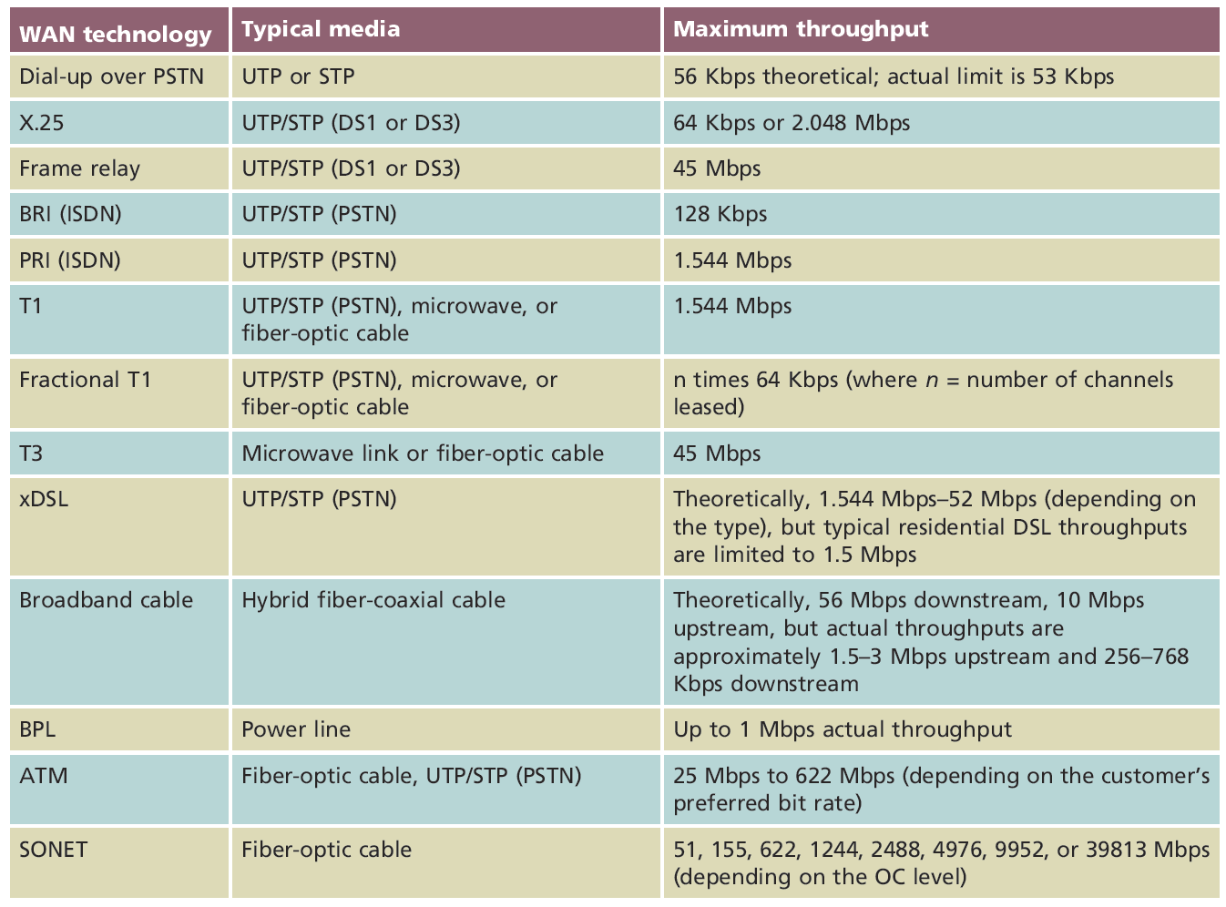
WAN Technologies Quick Reference

Slide 30
Virtualization

Slide 31
Virtualization
Emulation of a computer, operating system environment, or application:
  On a physical system
Virtual machines (VMs)
  Virtual workstations
  Virtual servers
  Can be configured to use different types of:
    CPU
    Storage drive
    NIC

Slide 32
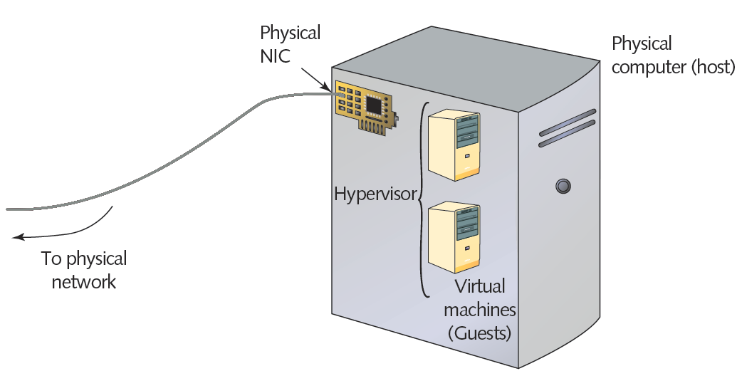
Elements of virtualization

Slide 33
Virtualization
Advantages
  Efficient use of resources
  Cost and energy savings
  Fault and threat isolation
  Simple backups, recovery, and replication
Disadvantages
  Compromised performance
  Increased complexity
  Increased licensing costs
  Single point of failure

Slide 34
Virtual Network Components
Virtual network
  Can be created to consist solely of virtual machines on a physical server
Most networks combine physical and virtual elements

Slide 35
Virtual Switches and Bridges
Virtual bridge or switch
  Created when first VM’s NIC is selected
  Connects VM with host
  Resides in RAM
Virtual switch
  Logically defined device
  Operates at Data Link layer
  Passes frames between nodes
Virtual bridge
  Connects vNICs with a network

Slide 36
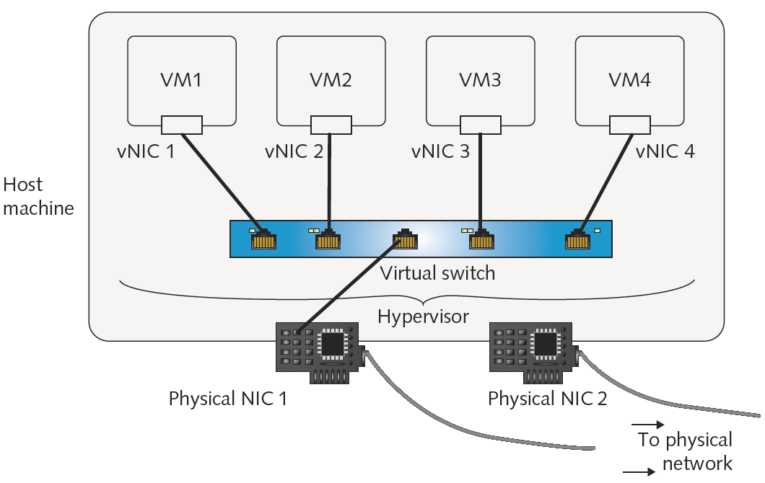
Virtual servers on a single host connected with a virtual switch

Slide 37
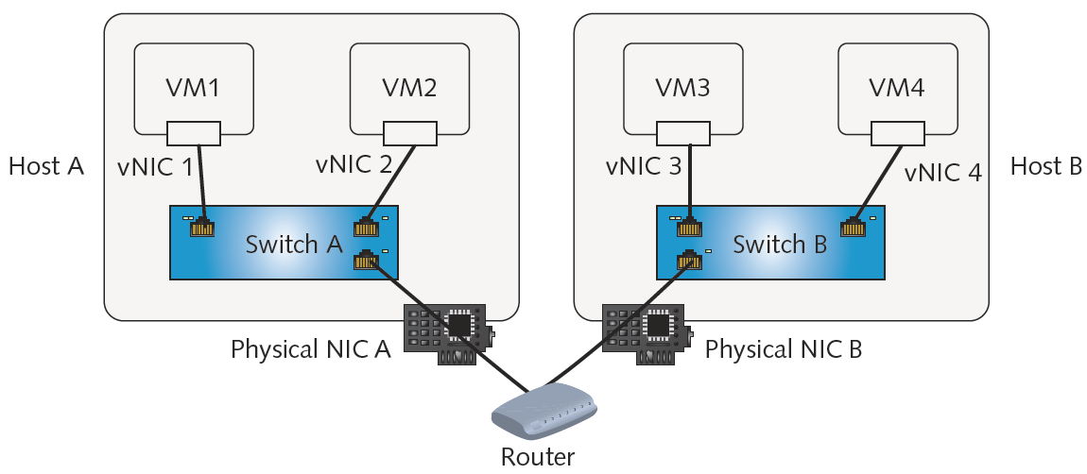
Virtual switches exchanging traffic through routers

Slide 38
Virtual Appliances
Alternative to test servers for new software
Virtual appliance includes:
  Image of operating system, software, hardware specifications, and application configuration
Most commonly virtual servers
Popular functions
  Firewall
  E-mail solutions
  Network management
  Remote access

Slide 39
Remote Virtual Computing
Allows workstation to remotely access and control another workstation
Host may allow clients a variety of privileges
Can send keystrokes and mouse clicks to the host
  Receive screen output in return
Thin client
  Workstation that uses such software to access LAN
  Requires very little hard disk space or processing power

Slide 40
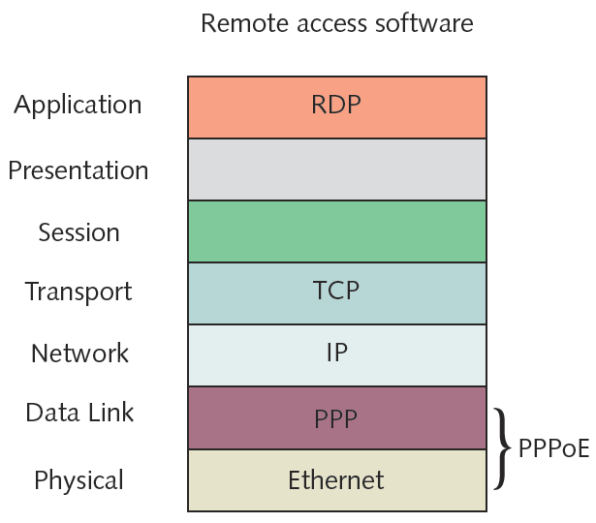
Protocols used in a remote access Internet connection

Slide 41
Remote Virtual Computing
Advantages
  Simple to configure
  Runs over any connection type
  Single host can accept simultaneous connections from multiple clients
Popular programs
  Microsoft Remote Desktop
  VNC (Virtual Network Computing)
  ICA (Independent Computing Architecture)

Slide 42
Remote Virtual Computing
Remote desktop
  Comes with Windows client and server operating systems
VNC (Virtual Network Computing)
  Open source system
ICA (Independent Computing Architecture)
  Citrix System’s XenApp
  Can work with virtually any operating system or application
  Easy to use

Slide 43
VPNs (Virtual Private Networks)
Logically defined networks over public transmission systems
  Isolated from other traffic on same public lines
Requires inexpensive software
Important considerations
  Interoperability
  Security
Types
  Site-to-site
  Client-to-site

Slide 44
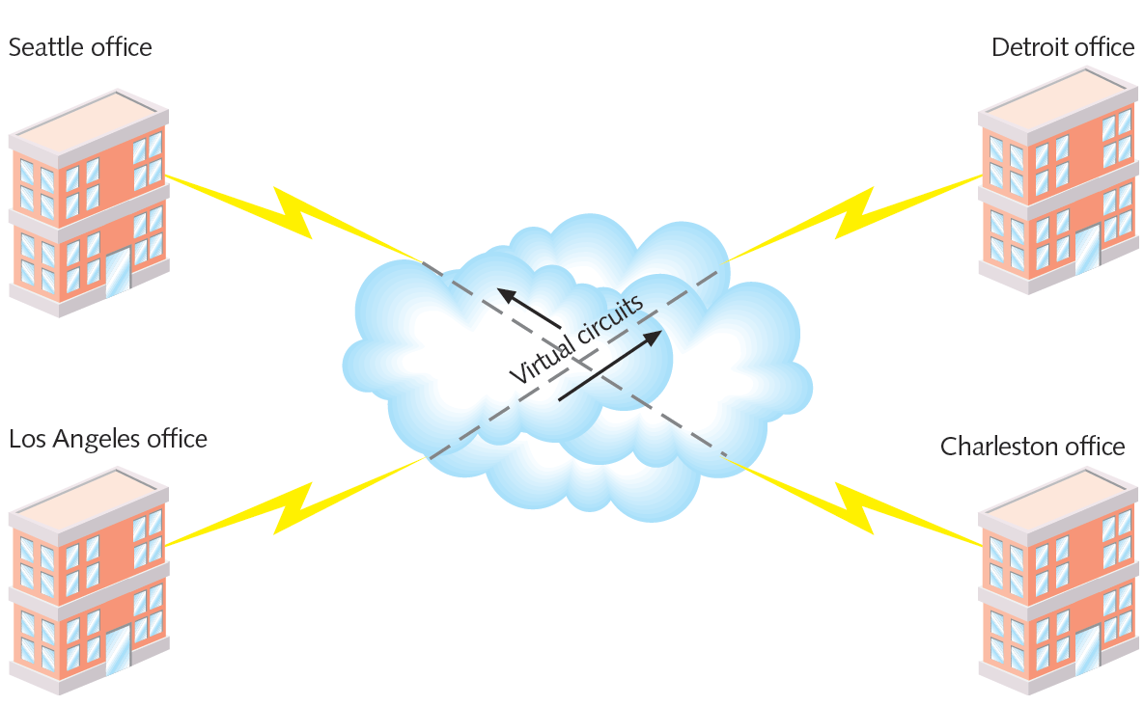
Site-to-site VPN

Slide 45
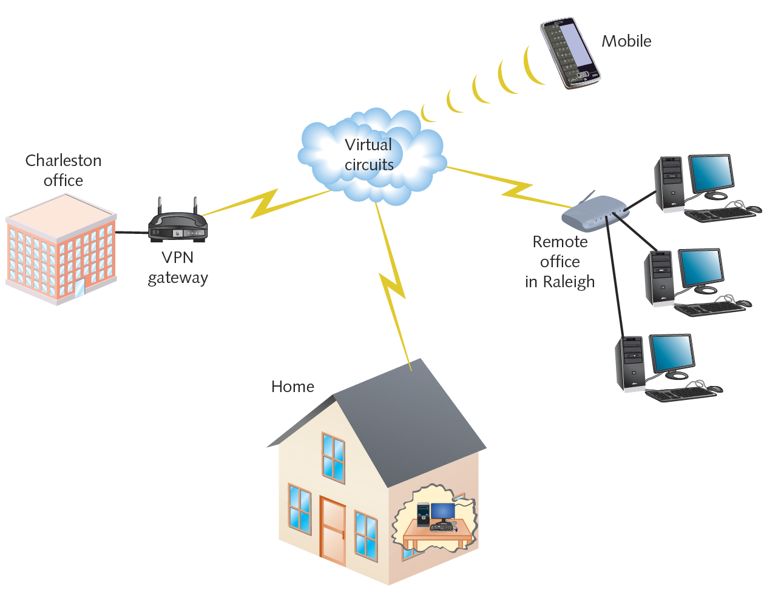
Client-to-site VPN (Remote Access VPN)

Slide 46
VPNs
Enterprise-wide VPN
  Can include elements of client-to-site and site-to-site models
VPNs tailored to customer’s distance, user, and bandwidth needs
Two major types of tunneling protocols
  PPTP (Point-to-Point Tunneling Protocol)
  L2TP (Layer 2 Tunneling Protocol)

