Slide 1
Network Security

Slide 2
Overview
Network Security
Summarize the purposes of physical security devices.
Explain authentication and access controls.
Given a scenario, secure a basic wireless network.
Summarize common networking attacks.
Given a scenario, implement network device hardening.
Explain common mitigation techniques and their purposes.

Slide 3
Security Assessment
Examine network’s security risks
  Consider effects
Different organization types
  Different network security risk levels
Posture assessment
  Thorough network examination
  Determine possible compromise points
  Performed in-house by IT staff
  Performed by third party

Slide 4
Security Risks
Hacker
  Individual who gains unauthorized access to systems
Vulnerability
  Weakness of a system, process, or architecture
Exploit
  Means of taking advantage of a vulnerability
Zero-day exploit
  Taking advantage of undiscovered software vulnerability
  Most vulnerabilities are well known

Slide 5
Risks Associated with People
Half of all security breaches
  Human errors, ignorance, omissions
Social engineering
  Strategy to gain password
  Phishing
    Glean access, authentication information
    Pose as someone needing information
Many risks associated with people exist
Easiest way to circumvent network security
  Take advantage of human error

Slide 6
Risks Associated with Transmission and Hardware
Physical, Data Link, and Network layer security risks
  Require more technical sophistication
Risks inherent in network hardware and design
  Transmission interception
    Man-in-the-middle attack
  Eavesdropping
    Networks connecting to Internet via leased public lines
  Sniffing
    Repeating devices broadcast traffic over entire segment

Slide 7
Risks Associated with Transmission and Hardware (cont’d.)
Risks inherent in network hardware and design (cont’d.)
  Port access via port scanner
    Unused switch, router, server ports not secured
  Private address availability to outside
    Routers not properly configured to mask internal subnets
  Router attack
    Routers not configured to drop suspicious packets

Slide 8
Risks Associated with Transmission and Hardware (cont’d.)
Risks inherent in network hardware and design (cont’d.)
  Access servers not secured, monitored
  Computers hosting sensitive data:
    May coexist on same subnet as public computers
  Insecure passwords
    Easily guessable or default values

Slide 9
Risks Associated with Protocols and Software
Includes Transport, Session, Presentation, and Application layers
Networking protocols and software risks
  TCP/IP security flaws
  Invalid trust relationships
  NOS back doors, security flaws
  Buffer overflow
  NOS allows server operators to exit to command prompt
  Administrators default security options
  Intercepting transactions between applications

Slide 10
Risks Associated with Internet Access
Network security compromise
  More often “from the inside”
Outside threats still very real
  Web browsers permit scripts to access systems
  Users provide information to sites

Slide 11
Risks Associated with Internet Access (cont’d.)
Common Internet-related security issues
  Improperly configured firewall
    Outsiders obtain internal IP addresses: IP spoofing
  Telnets or FTPs
    Transmit user ID and password in plain text
  Newsgroups, mailing lists, forms
    Provide hackers user information
  Chat session flashing
  Denial-of-service attack
    Smurf attack: hacker issues flood of broadcast ping messages

Slide 12
An Effective Security Policy
Minimize break-in risk
  Communicate with and manage users
  Use thoroughly planned security policy
Security policy
  Identifies security goals, risks, authority levels, designated security coordinator, and team members
  Responsibilities of each employee
  How to address security breaches
Not included in policy:
  Hardware, software, architecture, and protocols
  Configuration details

Slide 13
Security Policy Goals
Typical goals
  Ensure authorized users have appropriate resource access
  Prevent unauthorized user access
  Protect unauthorized sensitive data access
    Inside and outside
  Prevent accidental hardware and software damage
  Prevent intentional hardware or software damage
  Create secure environment
    Withstand, respond to, and recover from threat
  Communicate employees’ responsibilities

Slide 14
Security Policy Goals (cont’d.)
Strategy
  Form committee
    Involve as many decision makers as possible
    Assign security coordinator to drive policy creation
  Understand risks
    Conduct posture assessment
    Rate severity and likelihood of each threat
  Assign person responsible for addressing threats

Slide 15
Security Policy Content
Outline policy content
  Define policy subheadings
Explain to users:
  What they can and cannot do
  How measures protect network’s security
User communication
  Security newsletter
  User security policy section
Define what confidential means to the organization

Slide 16
Response Policy
Security breach occurrence
  Provide planned response
Identify response team members
  Understand security policy, risks, and measures in place
  Accept role with certain responsibilities
  Regularly rehearse defense
    Threat drill

Slide 17
Response Policy (cont’d.)
Suggested team roles
  Dispatcher
    Person on call; first to notice; alerted to problem
  Manager
    Coordinates resources
  Technical support specialist
    One focus: solve problem quickly
  Public relations specialist
    Official spokesperson to public
After problem resolution
  Review process

Slide 18
Physical Security
Restrict physical access to network components
  Lock computer rooms, telco rooms, wiring closets, and equipment cabinets
Locks can be physical or electronic
  Electronic access badges
  Locks requiring entrants to punch numeric code
  Bio-recognition access

Slide 19
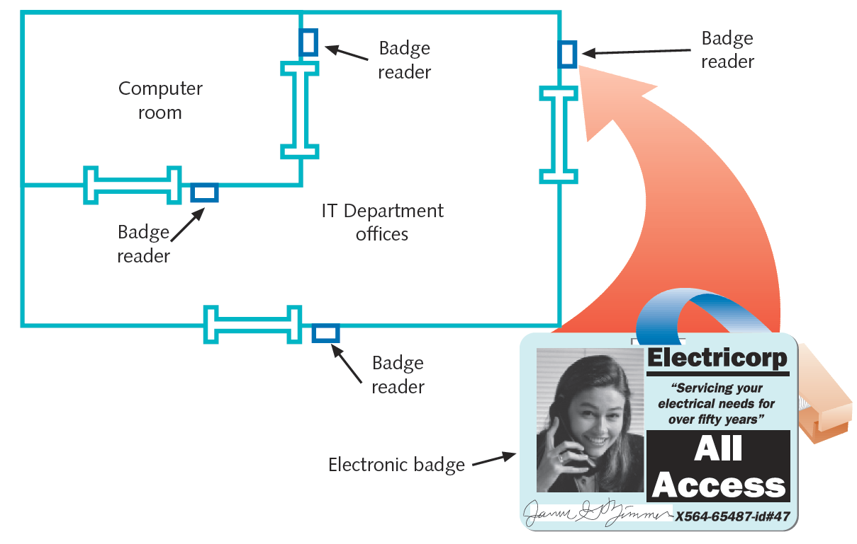

Slide 20
Physical Security (cont’d.)
Physical barriers
  Gates, fences, walls, and landscaping
Closed-circuit TV systems monitor secured rooms
Surveillance cameras
  Data centers, telco rooms, data storage areas, facility entrances
  Central security office capabilities
    Display several camera views at once
    Switch from camera to camera
  Video footage used in investigation and prosecution

Slide 21
Physical Security (cont’d.)
Security audit
  Ask questions related to physical security checks
Consider losses from salvaged and discarded computers
  Hard disk information stolen
  Solutions
    Run specialized disk sanitizer program
    Remove disk and use magnetic hard disk eraser
    Pulverize or melt disk

Slide 22
Security in Network Design
Breaches may occur due to poor LAN or WAN design
  Address though intelligent network design
Preventing external LAN security breaches
  Restrict access at every point where LAN connects to rest of the world

Slide 23
Router Access Lists
Control traffic through routers
Router’s main functions
  Examine packets
  Determine destination
    Based on Network layer addressing information
ACL (access control list)
  Also called access list
  Routers can decline to forward certain packets

Slide 24
Router Access Lists (cont’d.)
ACL variables used to permit or deny traffic
  Network layer protocol (IP, ICMP)
  Transport layer protocol (TCP, UDP)
  Source IP address
  Source netmask
  Destination IP address
  Destination netmask
  TCP or UDP port number

Slide 25
Router Access Lists (cont’d.)
Router receives packet, examines packet
  Refers to ACL for permit, deny criteria
  Drops packet if deny characteristics match
  Forwards packet if permit characteristics match
Access list statement examples
  Deny all traffic from source address with netmask 255.255.255.255
  Deny all traffic destined for TCP port 23
Separate ACL’s for:
  Interfaces; inbound and outbound traffic

Slide 26
Intrusion Detection and Prevention
Proactive security measure
  Detecting suspicious network activity
IDS (intrusion detection system)
  Software monitoring traffic
    On dedicated IDS device
    On another device performing other functions
Port mirroring
  One port makes copy of traffic to second port for monitoring

Slide 27
Intrusion Detection and Prevention (cont’d.)
IDS software detects many suspicious traffic patterns
  Examples: denial-of-service, smurf attacks
DMZ (demilitarized zone)
  Network’s protective perimeter
  IDS sensors installed at network edges
IDS at DMZ drawback
  Number of false positives logged
IDS can only detect and log suspicious activity

Slide 28
Intrusion Detection and Prevention (cont’d.)
IPS (intrusion-prevention system)
  Reacts to suspicious activity when alerted
  Detects threat and prevents traffic from flowing to network
    Based on originating IP address
NIPS (network-based intrusion prevention)
  Protects entire networks
HIPS (host-based intrusion prevention)
  Protects certain hosts

Slide 29
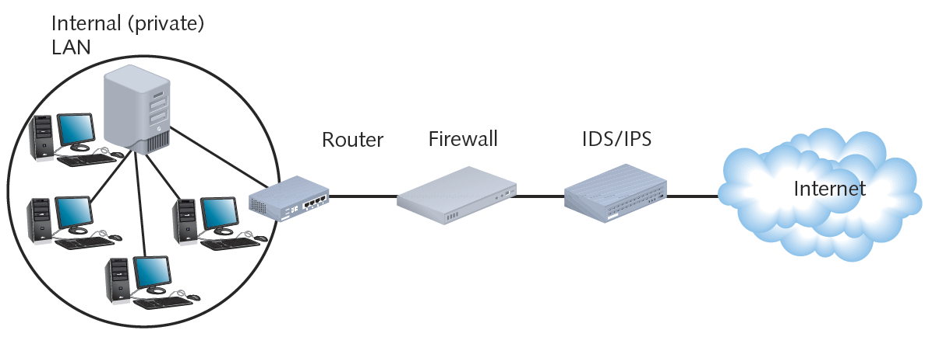

Slide 30
Firewalls
Specialized device or computer installed with specialized software
  Selectively filters and blocks traffic between networks
  Involves hardware and software combination
Firewall location
  Between two interconnected private networks
  Between private network and public network (network-based firewall)

Slide 31
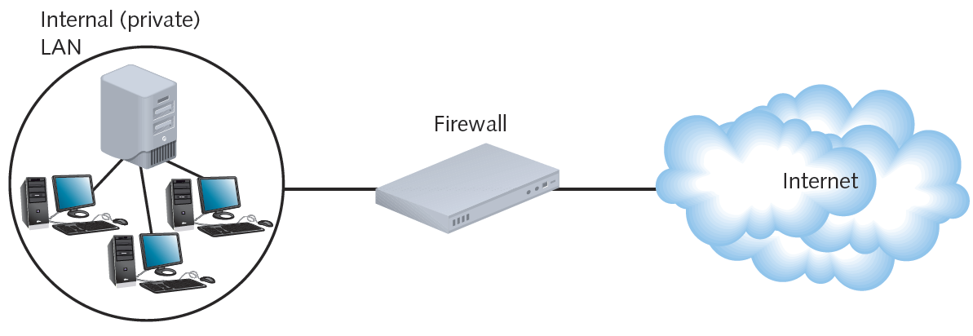

Slide 32
Firewalls (cont’d.)
Packet-filtering firewall
  Simplest firewall
  Examines header of every entering packet
  Can block traffic entering or exiting a LAN
Firewall default configuration
  Blocks most common security threats
  Preconfigured to accept and deny certain traffic types
  Network administrators often customize settings

Slide 33
Firewalls (cont’d.)
Common packet-filtering firewall criteria
  Source, destination IP addresses
  Source, destination ports
  Flags set in the IP header
  Transmissions using UDP or ICMP protocols
  Packet’s status as first packet in new data stream, subsequent packet
  Packet’s status as inbound to, outbound from private network

Slide 34
Firewalls (cont’d.)
Port blocking
  Prevents connection to and transmission completion through ports
Optional firewall functions
  Encryption
  User authentication
  Central management
  Easy rule establishment
  Filtering based on data contained in packets

Slide 35
Firewalls (cont’d.)
Optional firewall functions (cont’d.)
  Logging, auditing capabilities
  Protect internal LAN’s address identity
  Monitor data stream from end to end (stateful firewall)
Tailoring a firewall
  Consider type of traffic to filter
  Consider exceptions to rules
Packet-filtering firewalls
  Cannot distinguish user trying to breach firewall from authorized user

Slide 36
Scanning Tools
Used during posture assessment
  Duplicate hacker methods
NMAP (Network Mapper)
  Designed to scan large networks
  Provides information about network and hosts
  Free to download
Nessus
  Performs more sophisticated scans than NMAP

Slide 37
Lures
Honeypot
  Decoy system that is purposefully vulnerable
  Designed to fool hackers and gain information about their behavior
Honeynet
  Network of honeypots

Slide 38
NOS (Network Operating System) Security
Restrict user authorization
  Access to server files and directories
  Public rights
    Conferred to all users
    Very limited
  Group users according to security levels
    Assign additional rights

Slide 39
Logon Restrictions
Additional restrictions to strengthen security
  Time of day
  Total time logged on
  Source address
  Unsuccessful logon attempts

Slide 40
Passwords
Choosing secure password
  Guards against unauthorized access
  Easy, inexpensive
Communicate password guidelines
  Use security policy
  Stress importance of company’s financial, personnel data security

Slide 41
Passwords (cont’d.)
Tips
  Change system default passwords
  Do not use familiar information or dictionary words
    Dictionary attack
  Use long passwords
    Letters, numbers, special characters
  Do not write down or share
  Change frequently
  Do not reuse
  Use different passwords for different applications

Slide 42
Encryption
Use of algorithm to scramble data
  Format read by algorithm reversal (decryption)
Designed to keep information private
Many encryption forms exist
Provides assurances
  Data not modified between being sent and received
  Data can be viewed only by intended recipient
  Data was not forged by an intruder

Slide 43
Key Encryption
Key
  Random string of characters
  Woven into original data’s bits
  Generates unique data block
Ciphertext
  Scrambled data block
Brute force attack
  Attempt to discover key
  Trying numerous possible character combinations

Slide 44
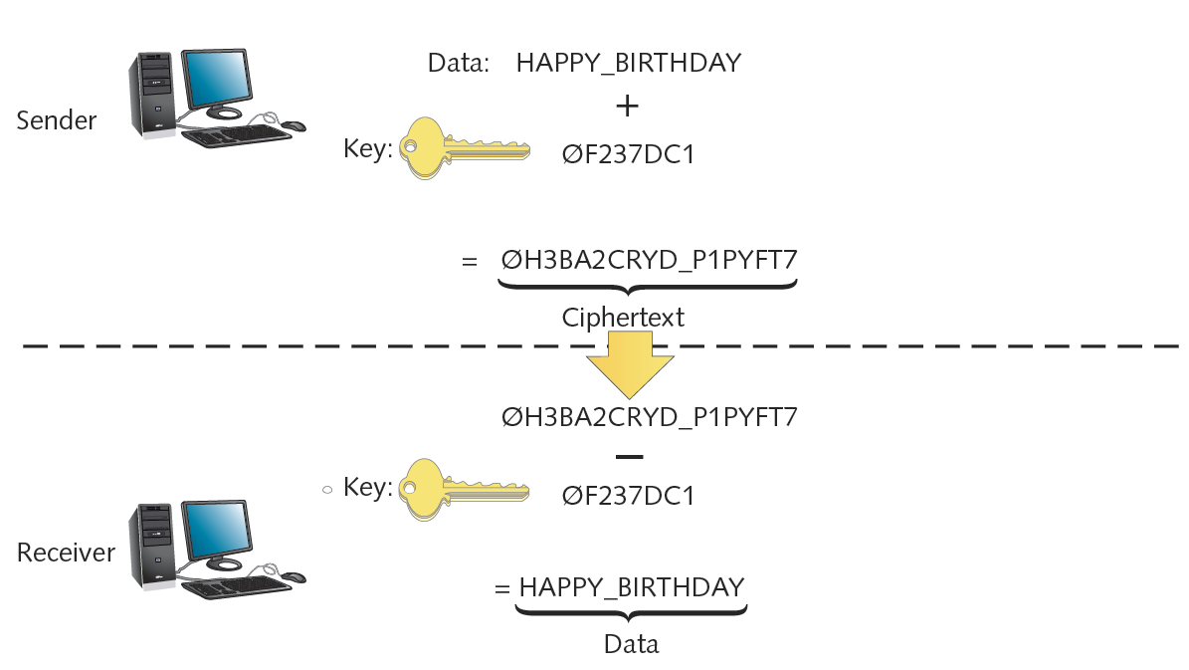

Slide 45
Key Encryption (cont’d.)
Private key encryption
  Data encrypted using single key
    Known only by sender and receiver
  Symmetric encryption
    Same key used during both encryption and decryption
DES (Data Encryption Standard)
  Most popular private key encryption
  IBM developed (1970s)
  56-bit key: secure at the time
Triple DES
  Weaves 56-bit key three times

Slide 46
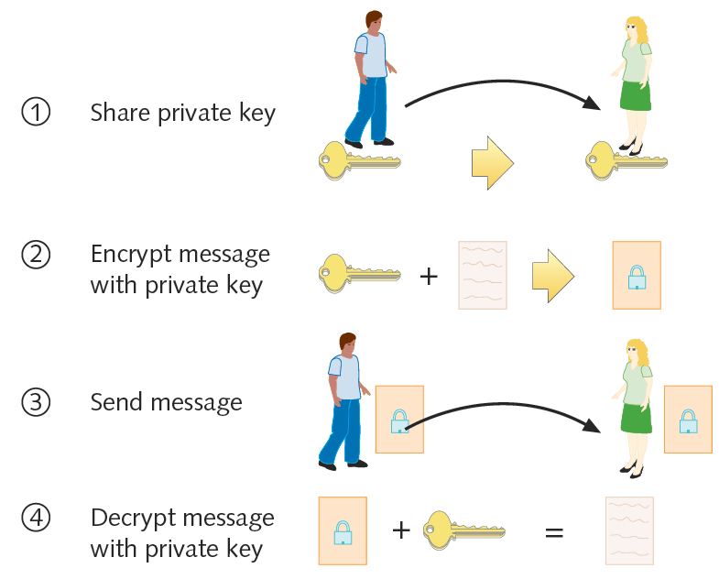
Private key encryption

Slide 47
Key Encryption (cont’d.)
AES (Advanced Encryption Standard)
  Weaves 128, 160, 192, 256 bit keys through data multiple times
  Popular form uses Rijndael algorithm
    More secure than DES
    Much faster than Triple DES
  Replaced DES in high security level situations
Private key encryption drawback
  Sender must somehow share key with recipient

Slide 48
Key Encryption (cont’d.)
Public key encryption
  Data encrypted using two keys
  Private key: user knows
  Public key: anyone may request
Public key server
  Publicly accessible host
  Freely provides users’ public keys
Key pair
  Combination of public key and private key
Asymmetric encryption
  Requires two different keys

Slide 49
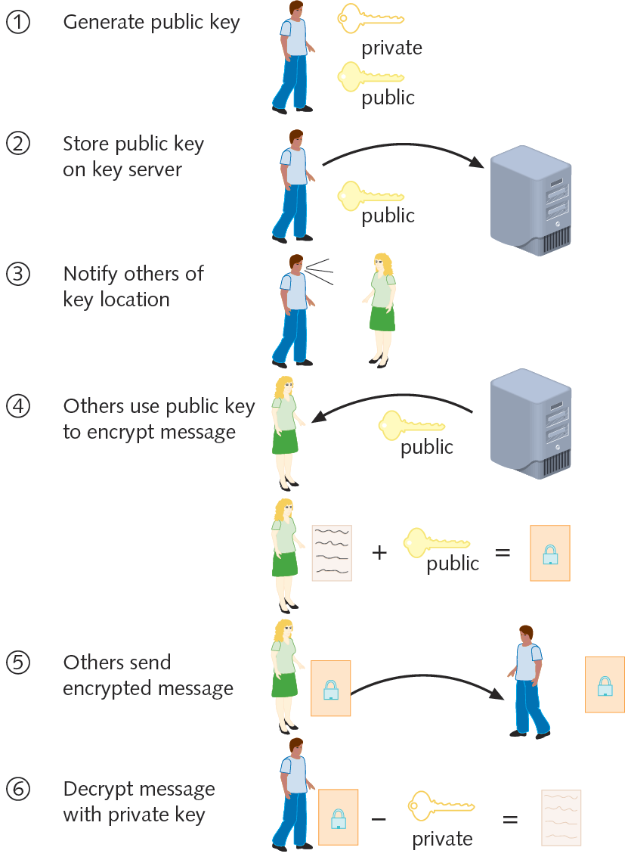
Public key encryption

Slide 50
Key Encryption (cont’d.)
Diffie-Hellman (1975)
  First public key algorithm
RSA
  Most popular
  Key creation
    Choose two large prime numbers, multiplying together
  May be used in conjunction with RC4
    Weaves key with data multiple times, as computer issues data stream

Slide 51
Key Encryption (cont’d.)
RC4
  Key up to 2048 bits long
  Highly secure and fast
Digital certificate
  Password-protected, encrypted file
  Holds identification information
  Includes public key

Slide 52
Key Encryption (cont’d.)
CA (certificate authority)
  Issues, maintains digital certificates
  Example: Verisign
PKI (public key infrastructure)
  Use of certificate authorities to associate public keys with certain users

Slide 53
PGP (Pretty Good Privacy)
Secures e-mail transmissions
Developed by Phil Zimmerman (1990s)
Public key encryption system
  Verifies e-mail sender authenticity
  Encrypts e-mail data in transmission
Administered at MIT
Freely available
  Open source and proprietary
Also used to encrypt storage device data

Slide 54
SSL (Secure Sockets Layer)
Encrypts TCP/IP transmissions
  Web pages and Web form data between client and server
  Uses public key encryption technology
Web pages using HTTPS
  HTTP over Secure Sockets Layer, HTTP Secure
  Data transferred from server to client (vice versa) using SSL encryption
HTTPS uses TCP port 443

Slide 55
SSH (Secure Shell)
Collection of protocols
Provides Telnet capabilities with security
Guards against security threats
  Unauthorized host access
  IP spoofing
  Interception of data in transit
  DNS spoofing
Encryption algorithm (depends on version)
  DES, Triple DES, RSA, Kerberos, others

Slide 56
SCP (Secure CoPy) and SFTP (Secure File Transfer Protocol)
SCP (Secure CoPy) utility
  Extension to OpenSSH
  Allows copying of files from one host to another securely
  Replaces insecure file copy protocols (FTP)
  Included with UNIX, Linux, and Macintosh OS X operating systems
Windows operating systems
  Some SSH programs include SCP utility
  Separate freeware SCP application: WinSCP

Slide 57
IPSec (Internet Protocol Security)
Defines encryption, authentication, key management for TCP/IP transmissions
Enhancement to IPv4
Native IPv6 standard
Difference from other methods
  Encrypts data
    Adds security information to all IP packet headers
  Transforms data packets
  Operates at Network layer (Layer 3)

Slide 58
IPSec (cont’d.)
Two phase authentication
  Key management
    Two nodes agree on common parameters for key use
    IKE (Internet Key Exchange)
  Encryption
    AH (authentication header)
    ESP (Encapsulating Security Payload)
Used with any TCP/IP transmission
  Most commonly runs on routers, connectivity devices in VPN context

Slide 59
Authentication Protocols (some…not all)
Authentication
  Process of verifying user’s credentials
    Grant user access to secured resources
Authentication protocols
  Rules computers follow to accomplish authentication
Several authentication protocol types
  Vary by encryption scheme:
    And steps taken to verify credentials

Slide 60
RADIUS and TACACS+
Centralized service
  Often used to manage resource access
AAA (authentication, authorization, and accounting)
  Category of protocols that provide service
  Establish client’s identity
  Examine credentials and allow or deny access
  Track client’s system or network usage

Slide 61
RADIUS and TACACS+ (cont’d.)
RADIUS (Remote Authentication Dial-In User Service)
  Defined by the IETF
  Runs over UDP
  Can operate as application on remote access server
    Or on dedicated RADIUS server
  Highly scalable
  May be used to authenticate wireless connections
  Can work in conjunction with other network servers

Slide 62
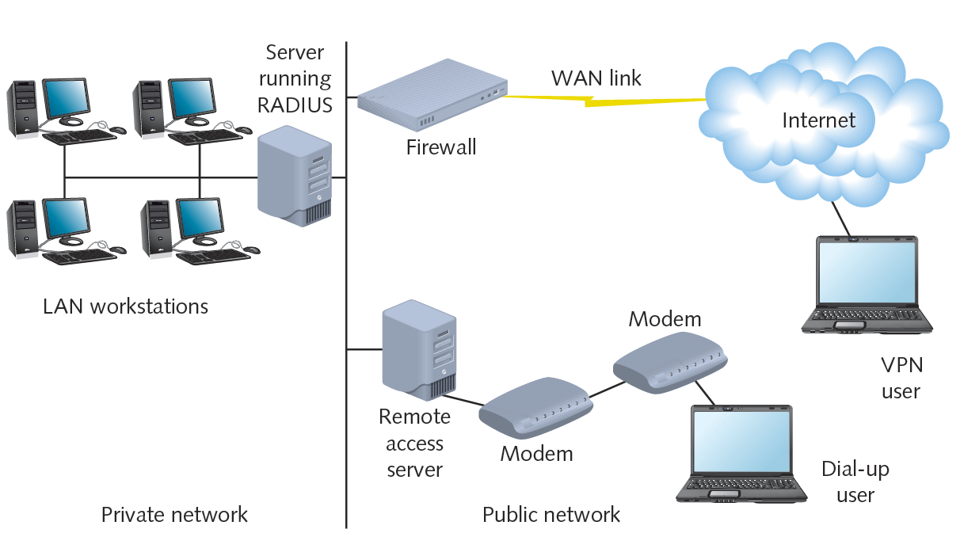
A RADIUS server on a network

Slide 63
RADIUS and TACACS+ (cont’d.)
TACACS+ (Terminal Access Controller Access Control System Plus)
  Separate access, authentication, and auditing capabilities
  Differences from RADIUS
    Relies on TCP at the Network layer
  Proprietary protocol developed by Cisco Systems, Inc.
  Typically installed on a router

Slide 64
Kerberos
Cross-platform authentication protocol
Uses key encryption
  Verifies client identity
  Securely exchanges information after client logs on
Private key encryption service
Provides significant security advantages over simple NOS authentication

