Slide 1

SMARTMET Training
Module 7 : IT Competency
Lesson 1: Information
Security Part 1

Slide 2
Outline
Todays information Security
What are the Security Objectives
Data breaches
Risk Analysis
Security controls
Data Protection
Image by kjpargeter on Freepik

Slide 3
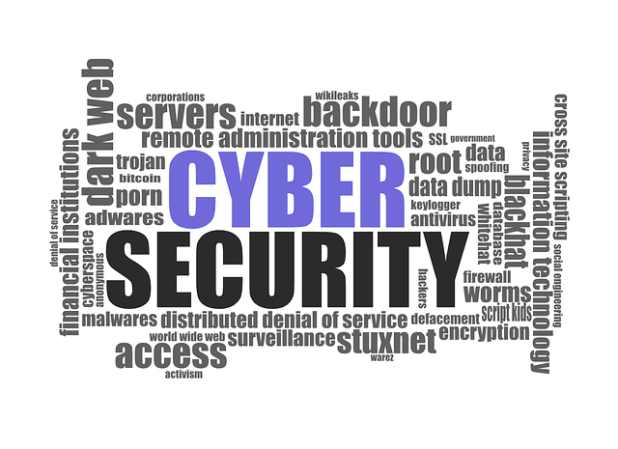
Todays Information Security
Information Security – keeping information assets protected
Increased ICT Landscape
  Proliferation of user devices
  BYOD, CYOD
  Cloud Services
  AI applications
Risk Management
  Increased threat vectors
  Increased threat actors
IT Security professionals upskilling
  Staying ahead

Slide 4
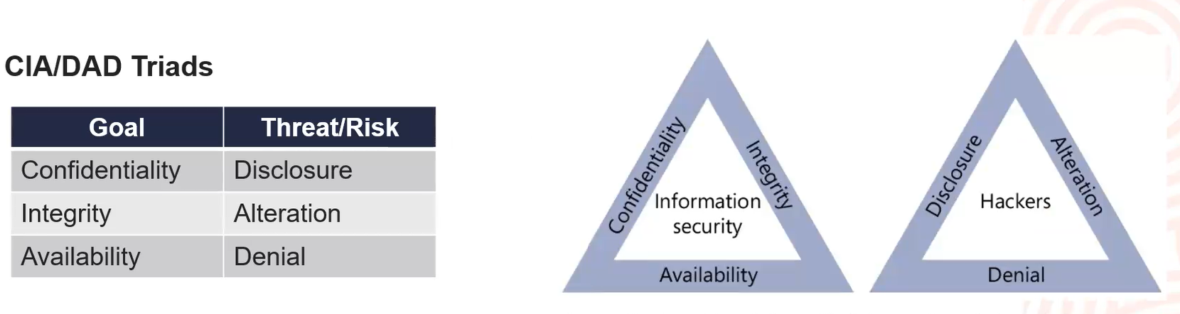
Security Primitives
3 objectives
  Confidentiality – keeping things secret
  Integrity – quality of data
  Availability – having access when needed
CIA Triad
  One security model, there are many
    McCumber Cube
    Cybersecurity Mature Model

Slide 5
Security Primitives
DAD Triad – comparative model to CIA
3 threats
  Disclosure – unauthorized access
    Data loss
    Data exfiltration
  Alteration – unauthorized change
  Denial – authorsied users unable to access systems/information
    Denial of service (DDOS)
Linkages

Slide 6

Data Breach
Security Incidents
  CIA compromised
  Can be at least one, two or all
Perpetuated by threat actors
3 states of information
  Rest
  transmitted
  processed
Impact of breaches
  what is the impact?
  how big is the impact?
  how wide it reaches?

Slide 7
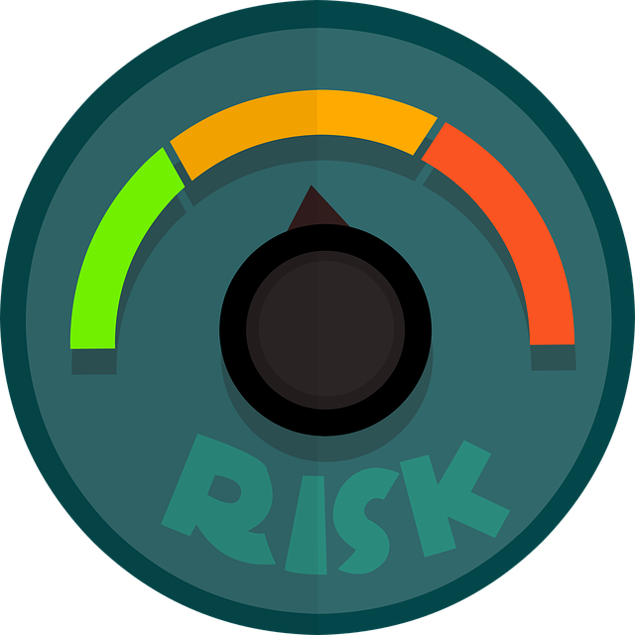
Risk Analysis
To protect we need to analyse the risks
What is our desired security state
Risk categories
  Financial – monetary damage
  Reputational – organisations image and public perception
  Strategic – achieving organisational goals and objectives
  Operational – day-to-day functions
  Compliance – legal and regulatory requirements

Slide 8
Data Protection
Organisational and customer data entrusted to us to protect
Data protection techniques – consider the 3 states where data exists
  Data Encryption – uses mathematical algorithms on data in transit and on storage
  Data Loss prevention – enforce information policies to prevent data loss and theft
    Host-based – e.g. use of clients and agents on hosts
    Network-based – monitors network traffic
  Data Minimization – reduce amount of information maintained on a regular basis
    Methods used
      Destroy
      De-identification
      Data Obfuscation e.g. hashing, tokenization, masking

Slide 9

Security Controls
Determine the type of controls
Cost benefit analysis
  Is it worth it? Does the impact of the breach outweigh the cost of the control?
  Alternatives?
Security control categories
  Technical – digital enforcement e.g. firewall, access control lists (ACLs)
  Operational – processes to manage technology e.g. monitoring access, logs
  Managerial – procedures focused on risk management e.g. annual risk assessments, change management

Slide 10
Security Controls
Security control types – security base on desired effect
  Preventative – intend to stop security issue before it occurs
  Detective – identify security event already occurred
  Corrective – remediate security issue
  Deterrent – prevent an attack
  Physical – security controls on the physical world
  Compensating – mitigate the risk associated with exceptions

Slide 11

Summary
Information/cybersecurity professionals are responsible for ensuring the security primitives of CIA is maintained
Data must be protected in transit, at rest, and in use
Data breaches have significant and diverse impacts on organisations
Security controls may be categorized based on their mechanism of action and intent
Best approach is to perform a risk analysis and then have multiple and overlapping controls or layers in place to address the risks
Reference List
  CIS Security
  ISO 27000
  NIST
  Sybex Comptia Security+ Guide

